Slide 2


Slide 3


Slide 4
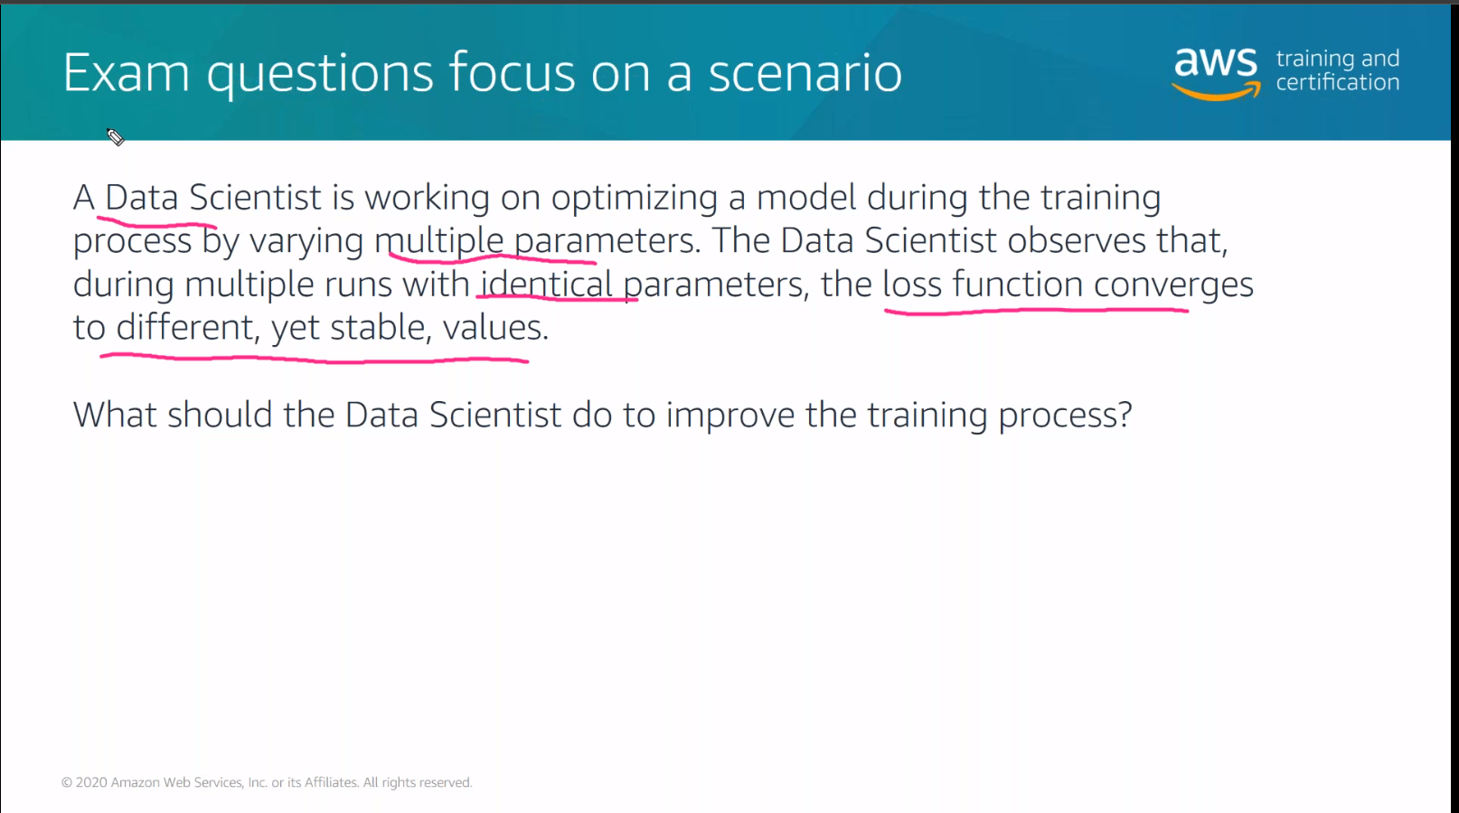

Slide 5
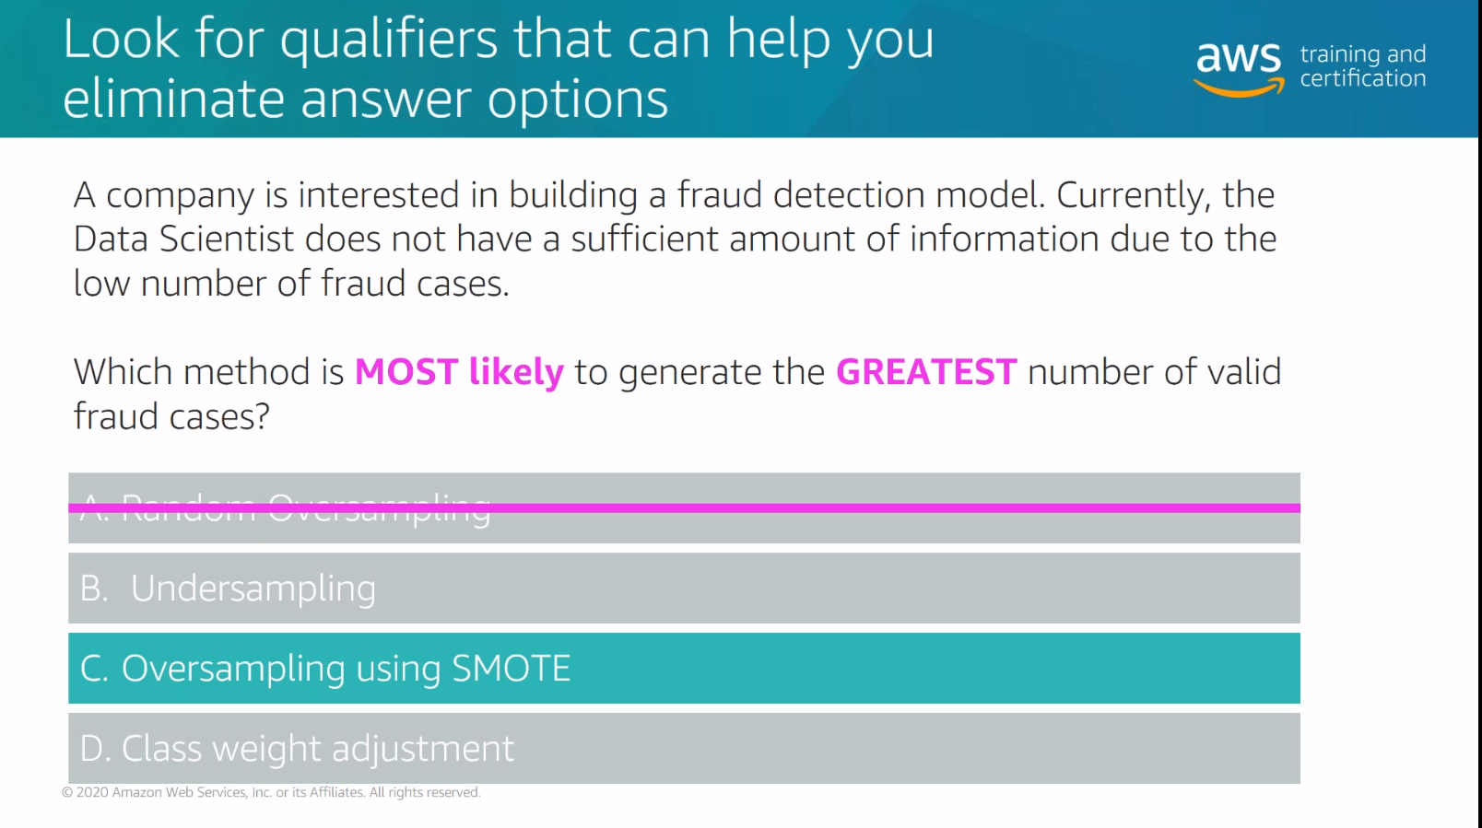

Slide 6
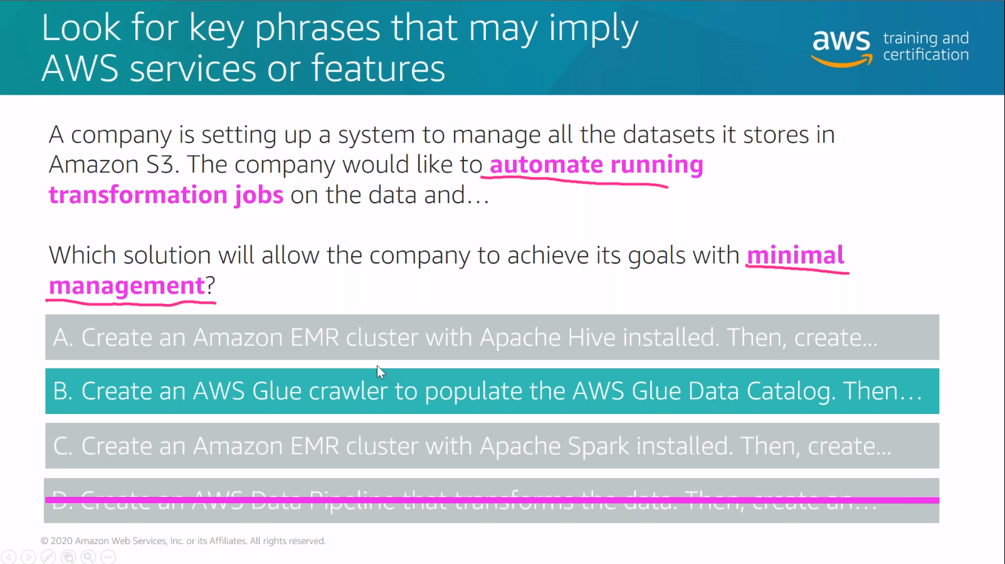

Slide 7
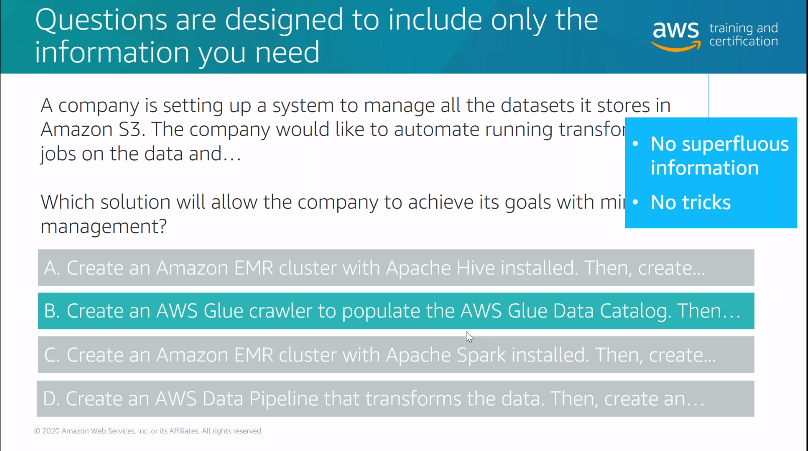

Slide 8
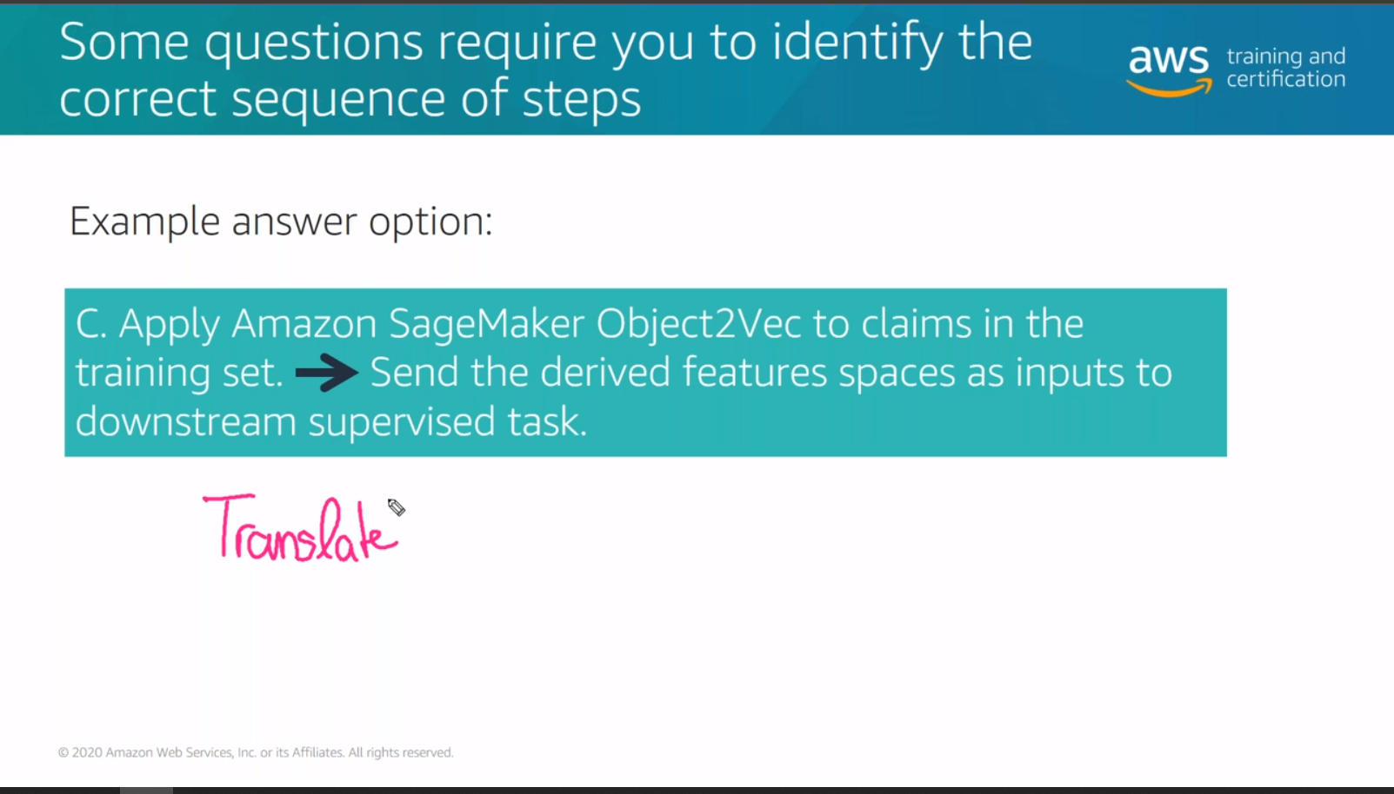

Slide 9


Slide 10
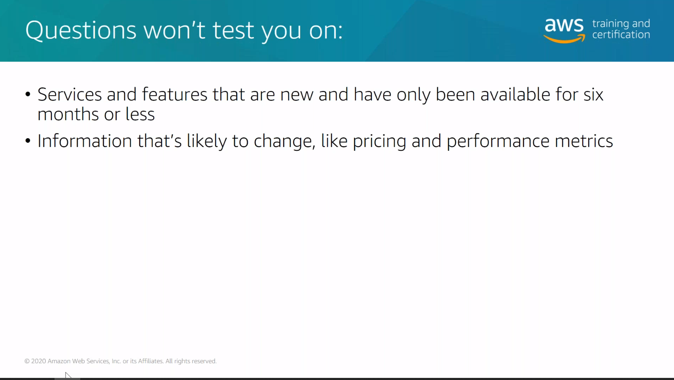

Slide 11


Slide 12


Slide 13
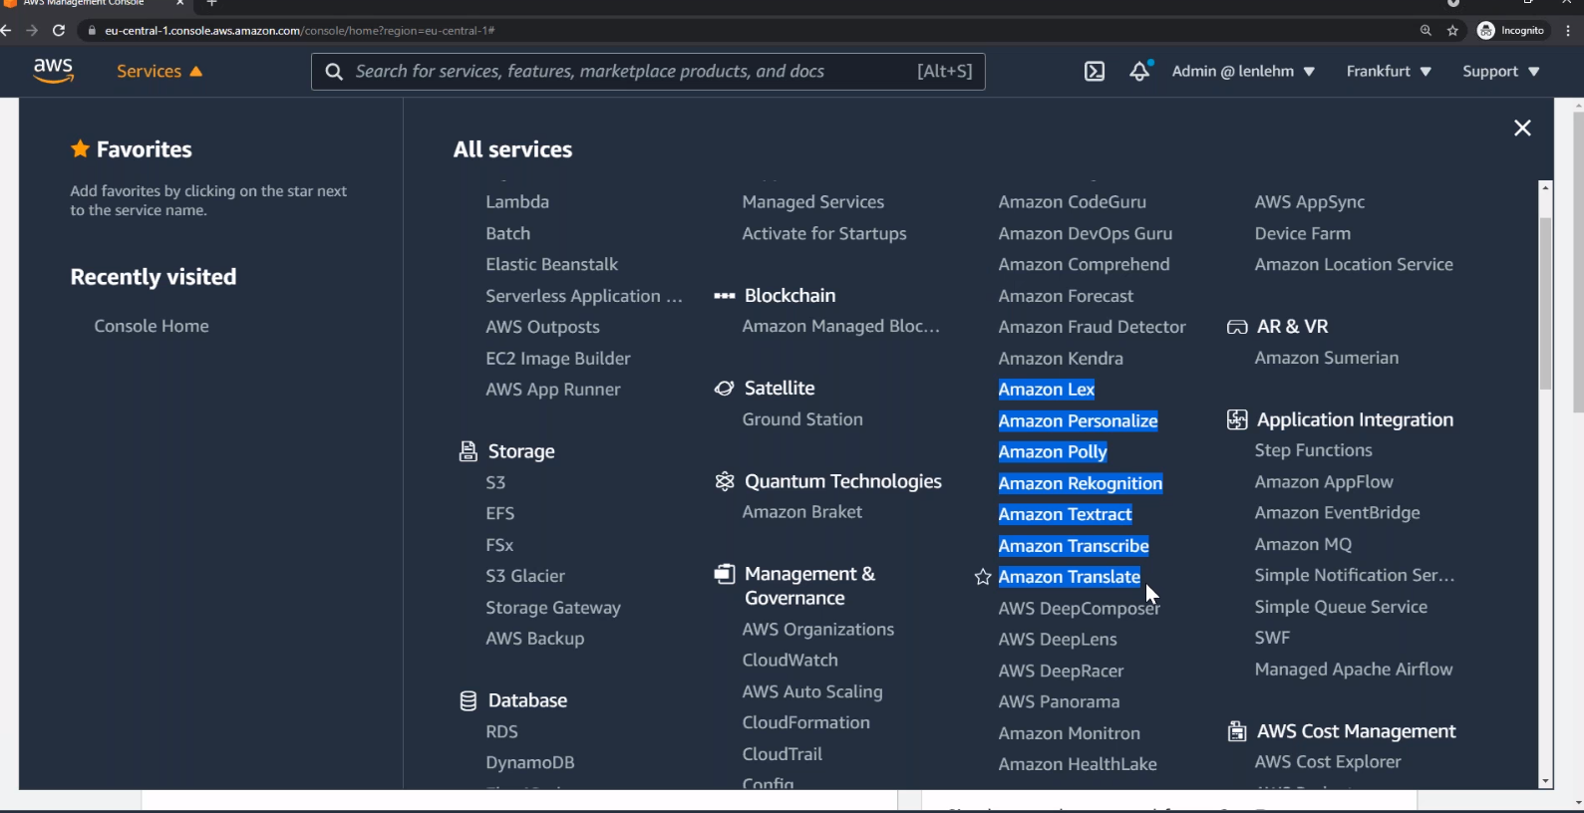

Slide 14
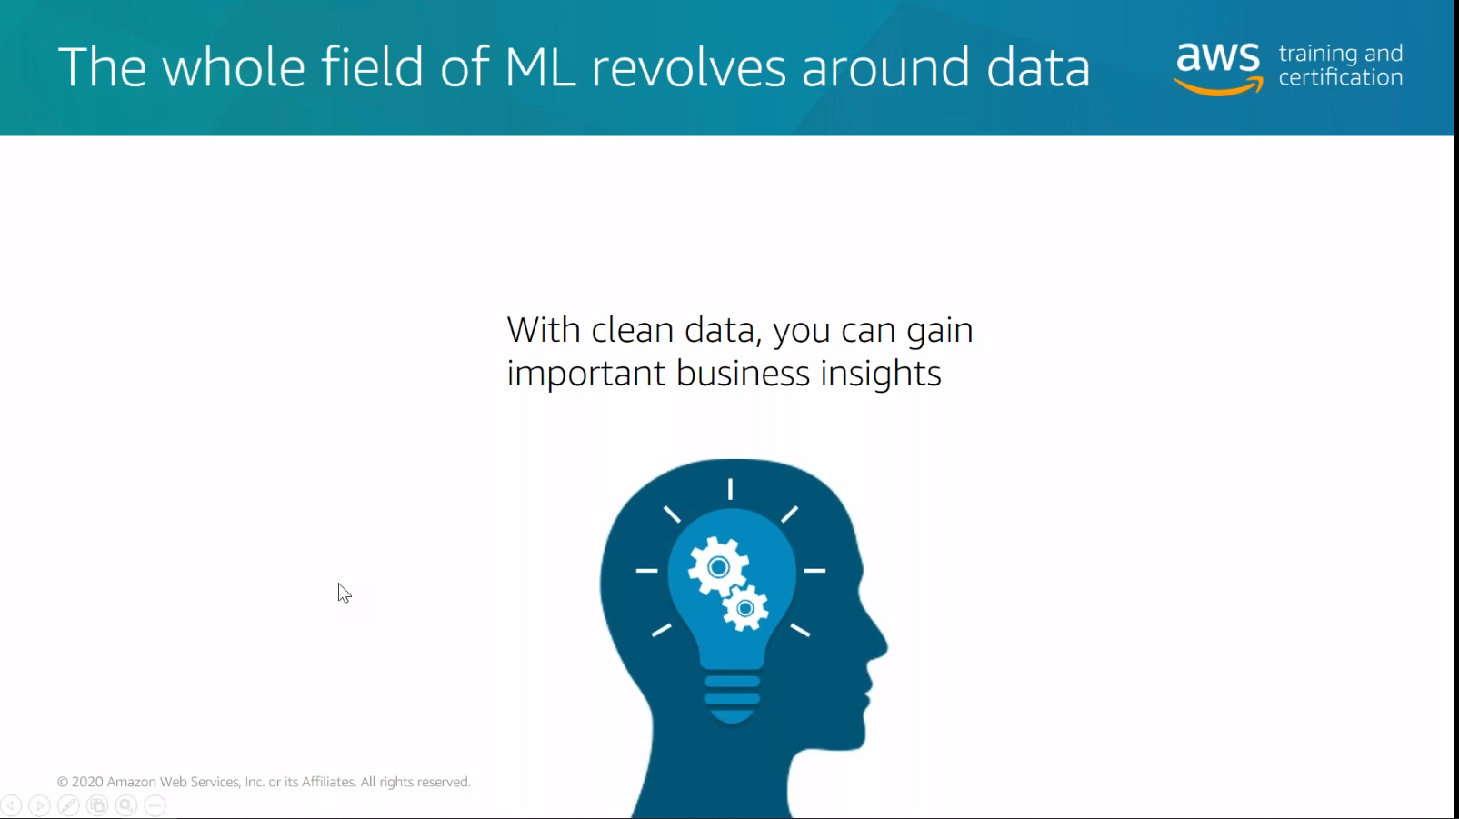

Slide 15
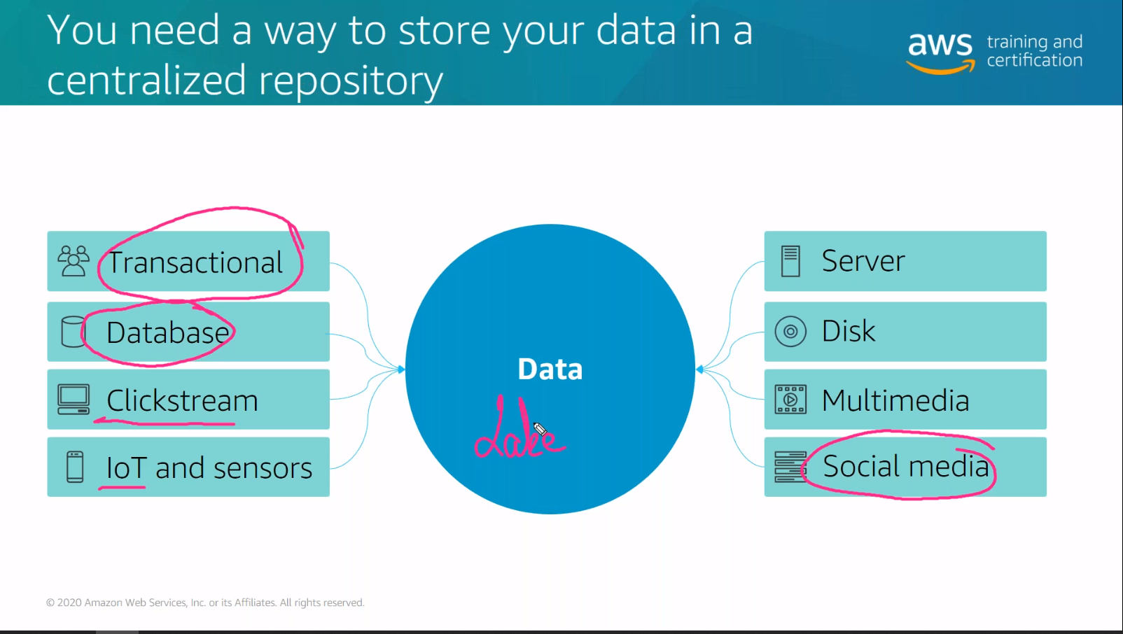

Slide 16
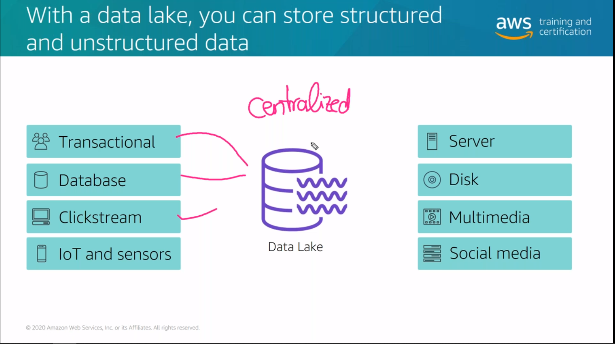

Slide 17
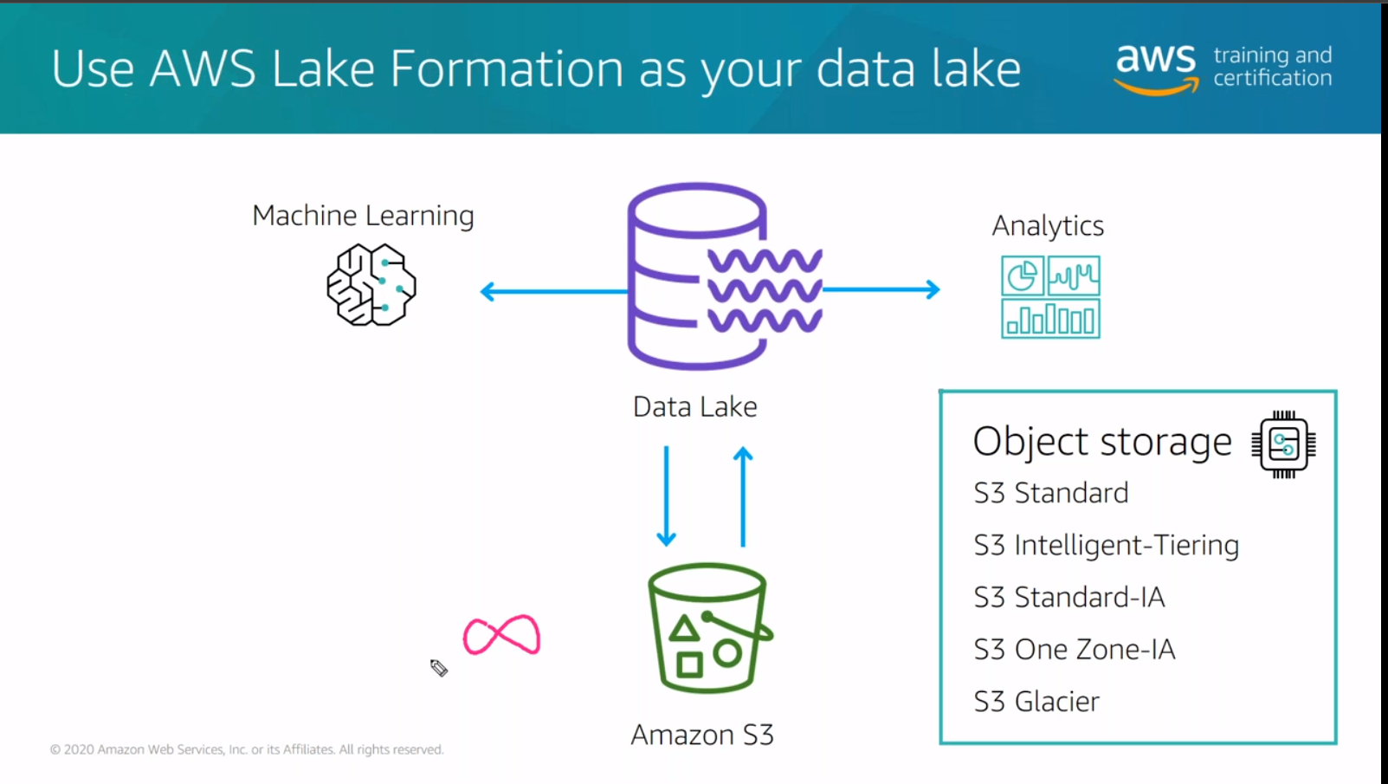

Slide 18
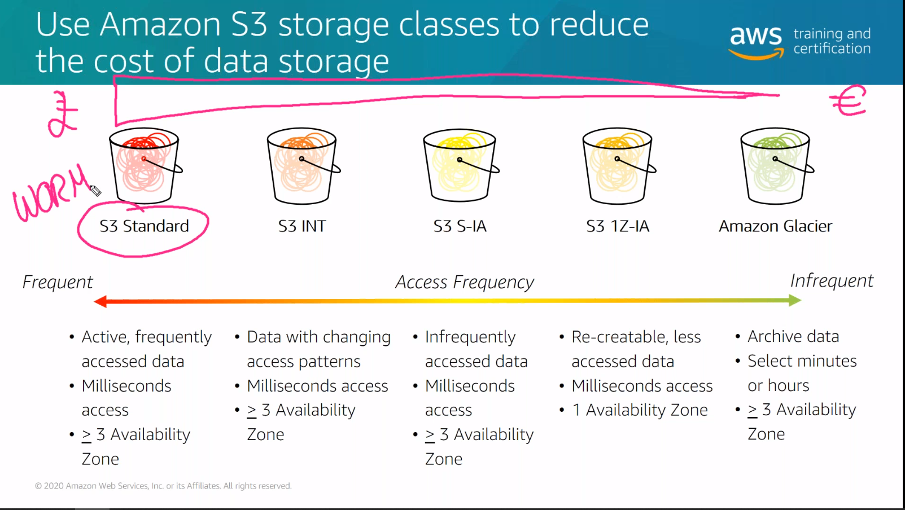
Notes:
WORM – write once read many

Slide 19
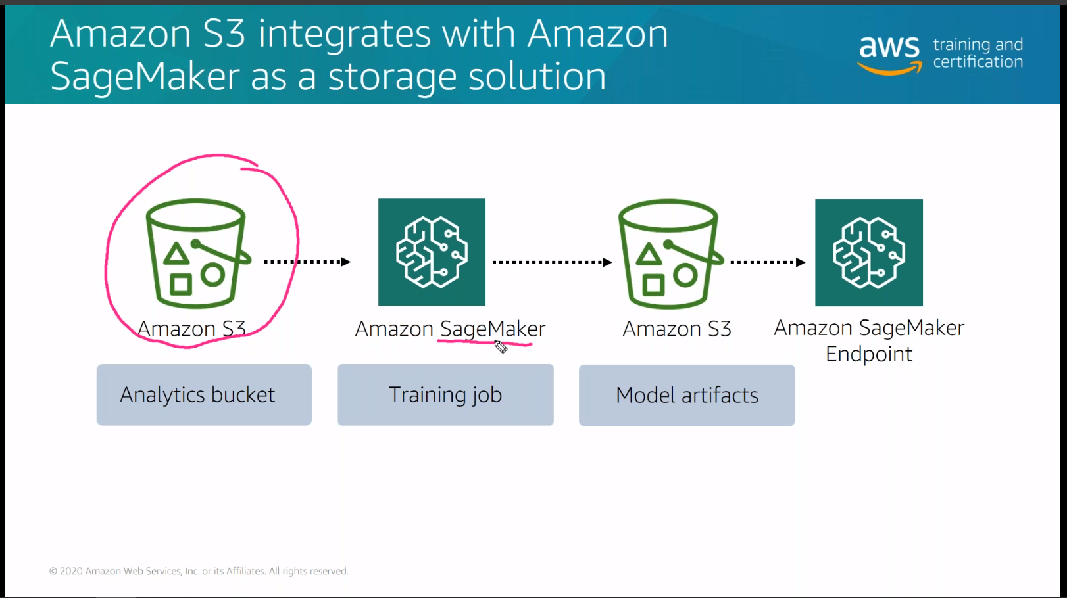

Slide 20
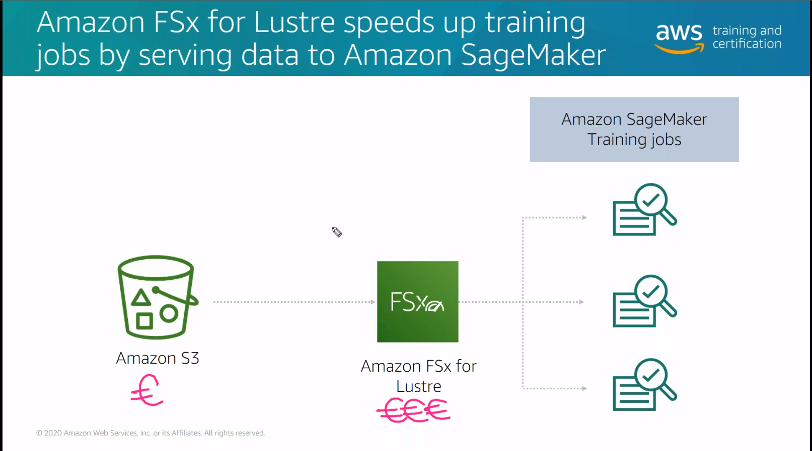
Notes:
High Throughput

Slide 21
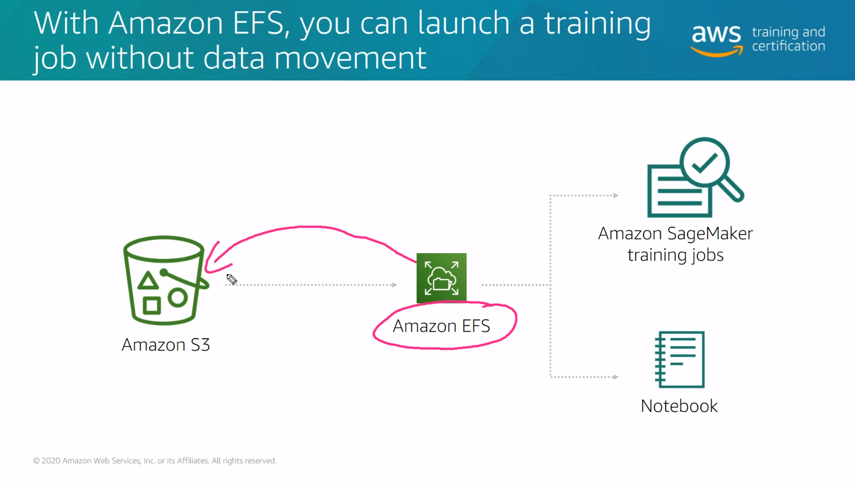
Notes:
EFS – Elastic File System

Slide 22
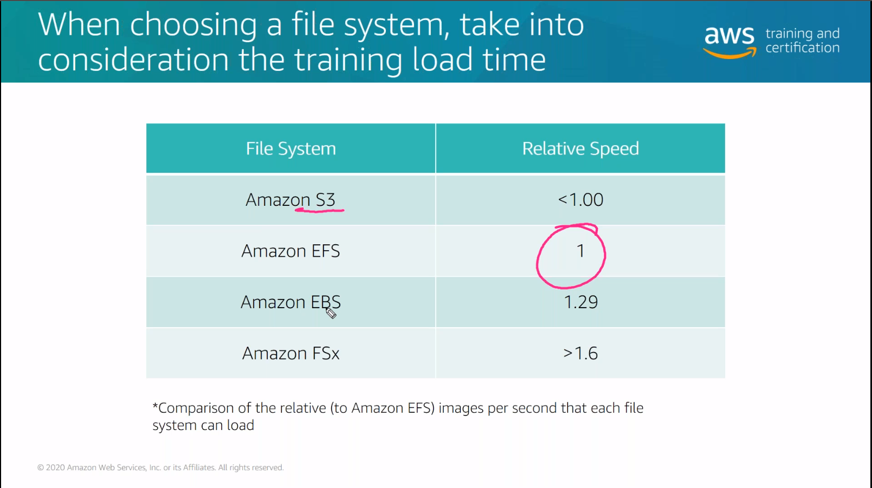
Notes:
Fsx is the fastest
99% time S3 is used for machine learning

Slide 23
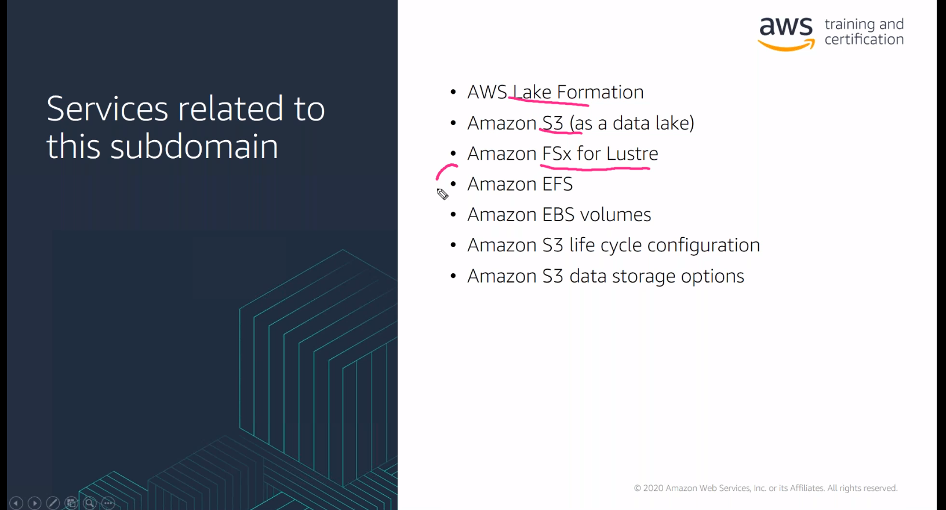

Slide 24


Slide 25
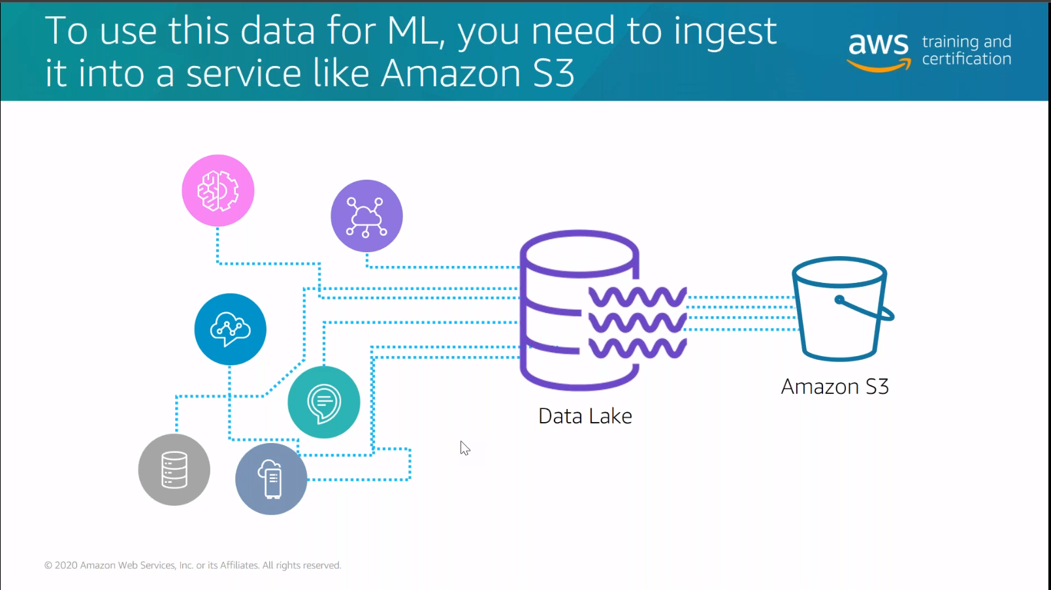

Slide 26
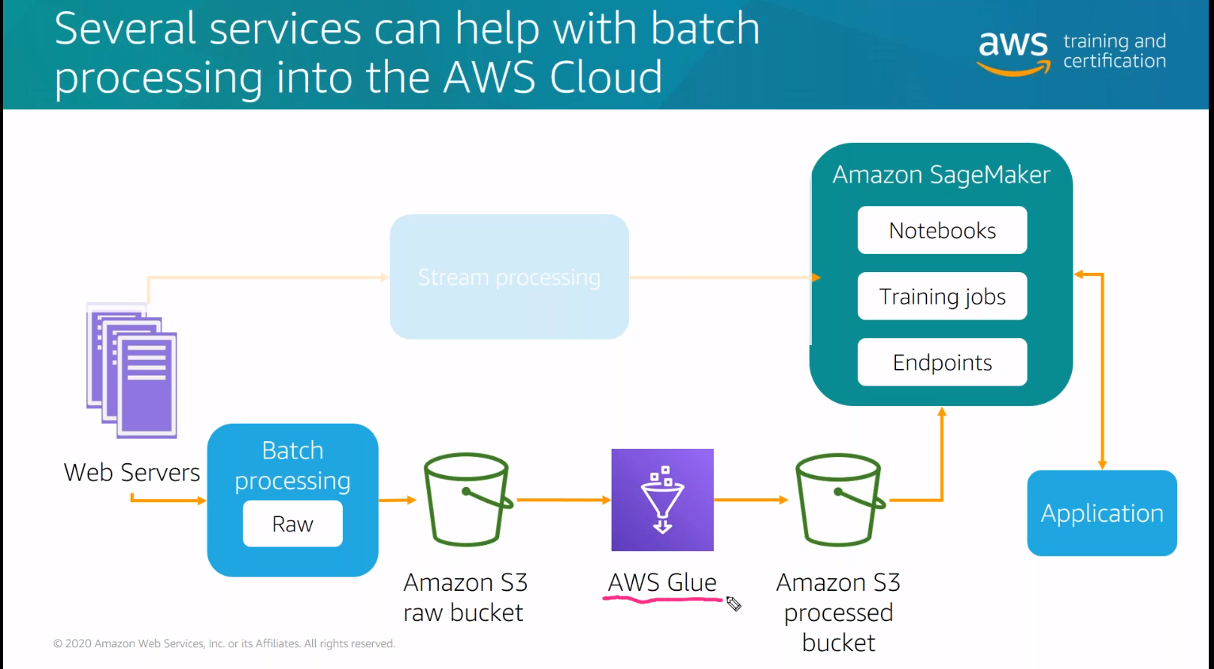
Notes:
AWS Glue is used for 99% transformation pipelines
Use FAQ’s for these services in the documentation page

Slide 27
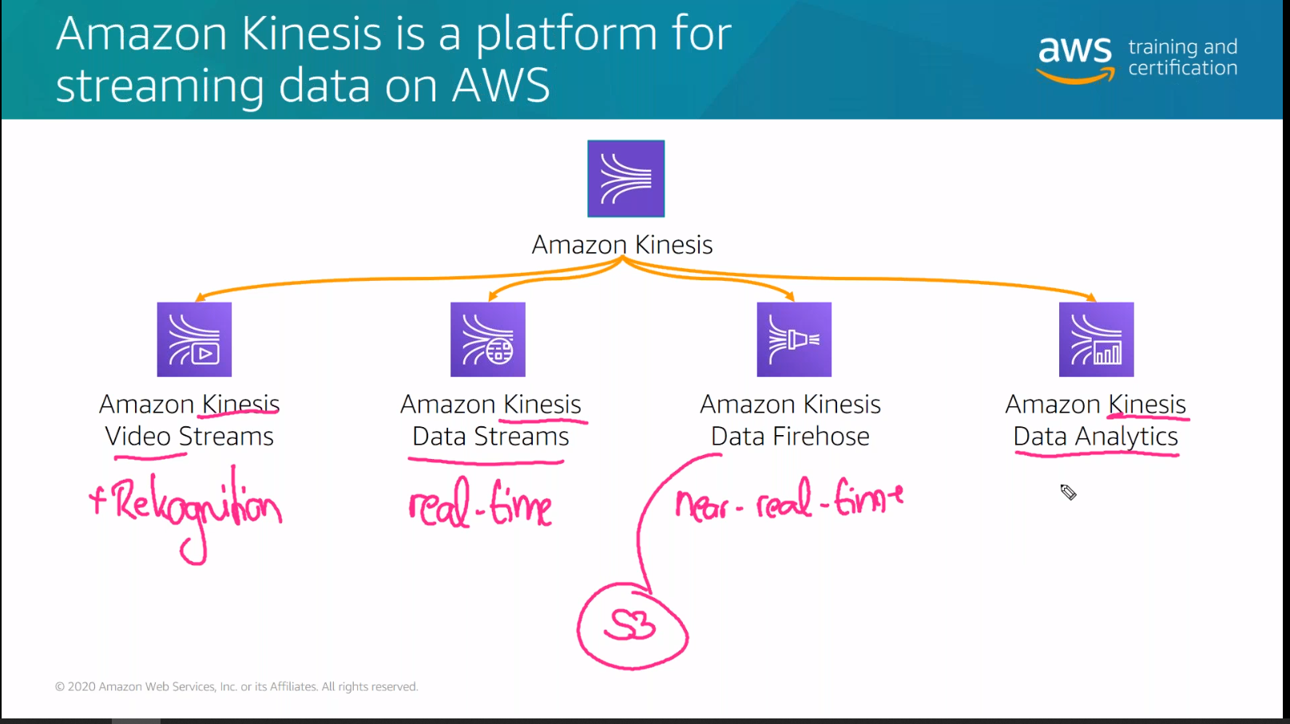

Slide 28
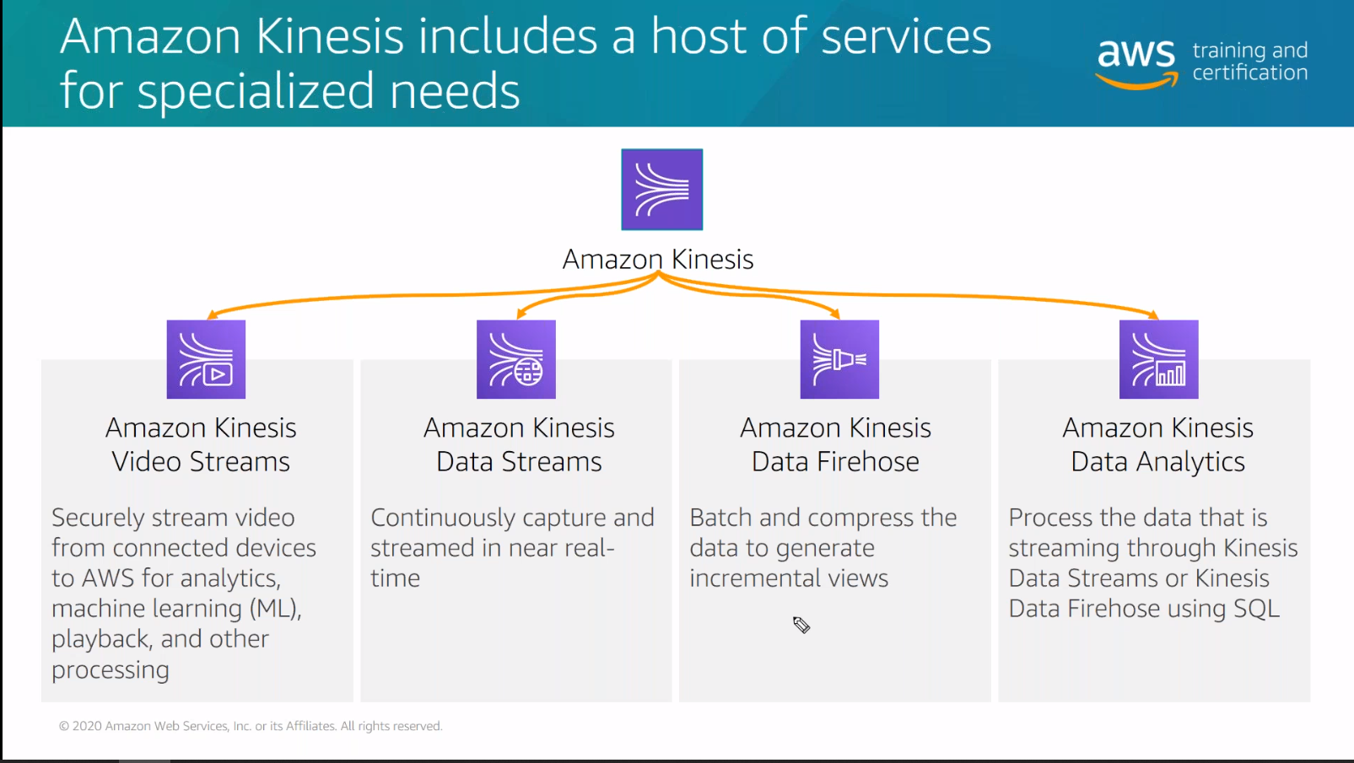

Slide 29
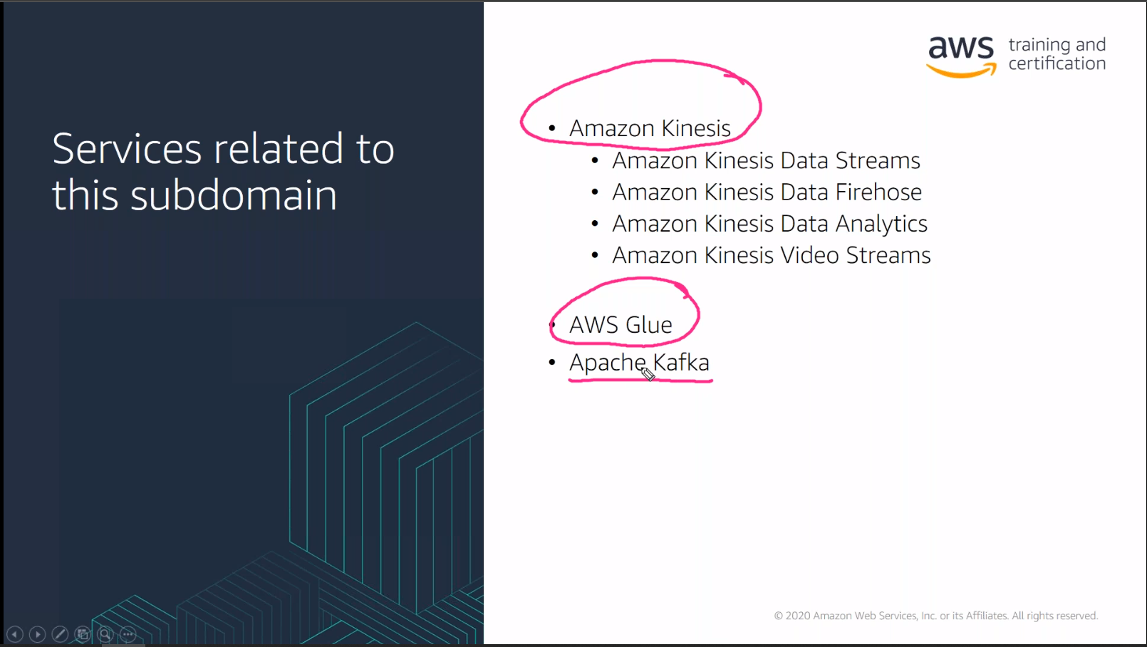

Slide 30
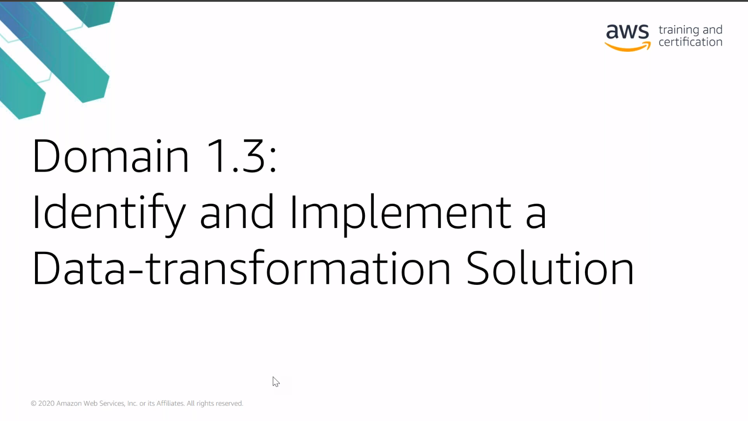

Slide 31
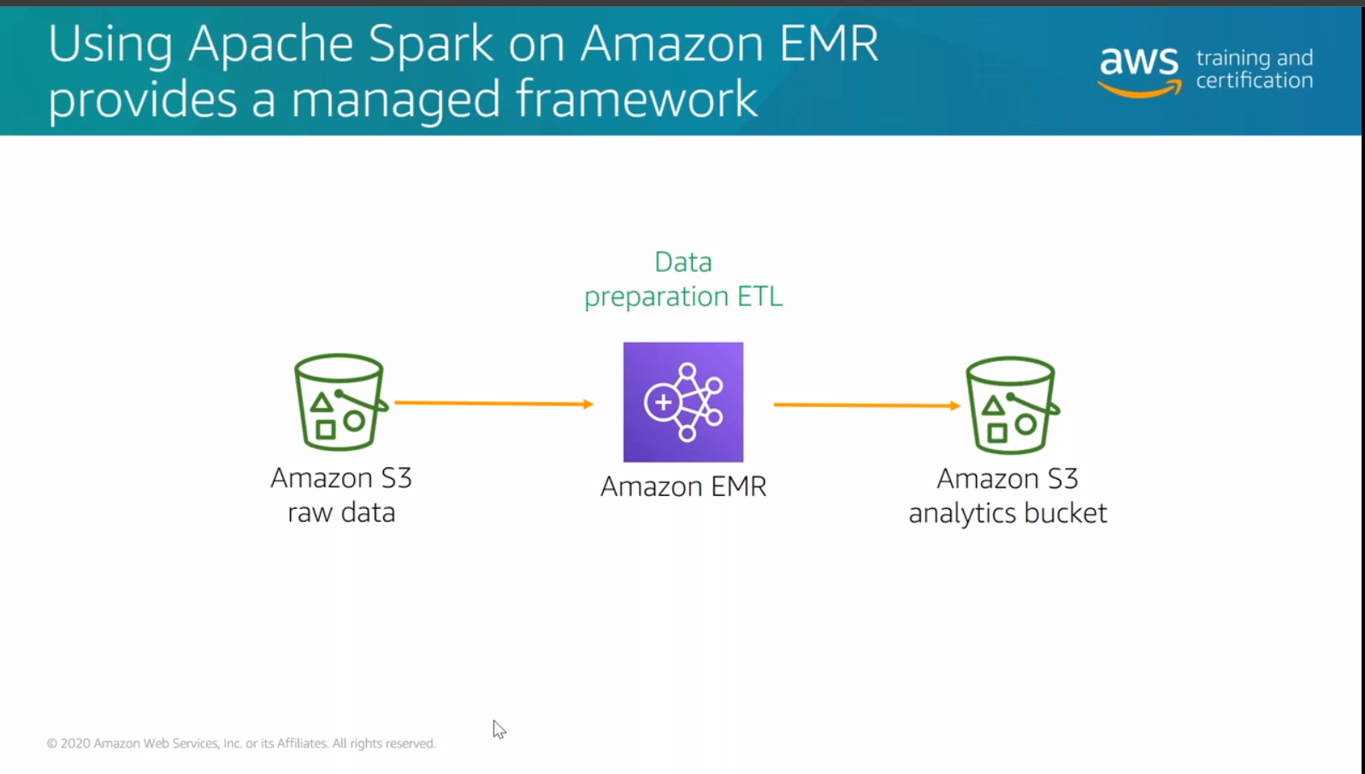
Notes:
EMR is kind of outdated. mostly used for apache spark

Slide 32
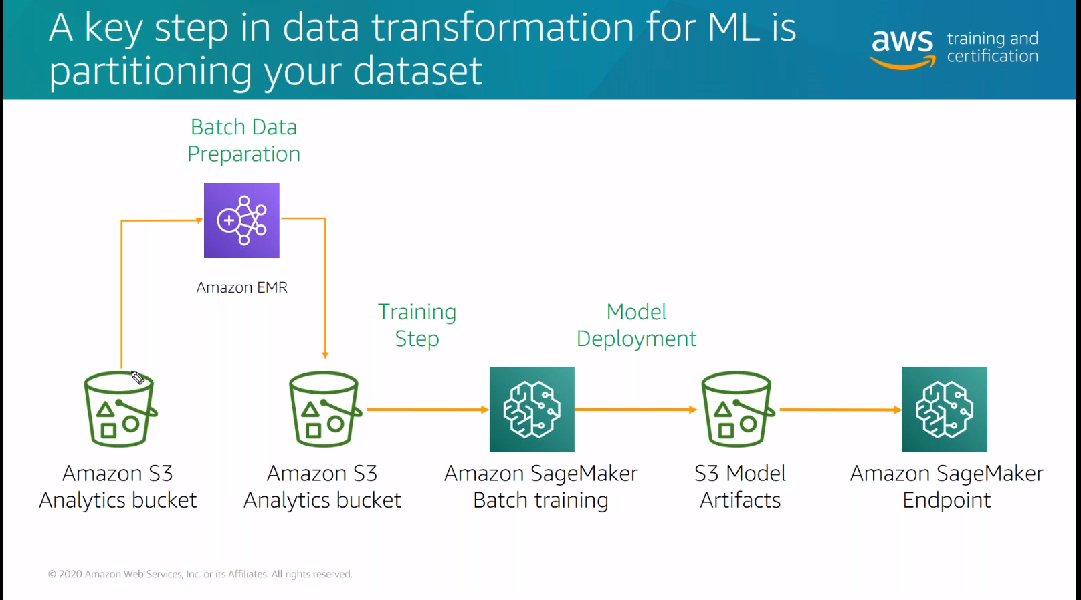

Slide 33
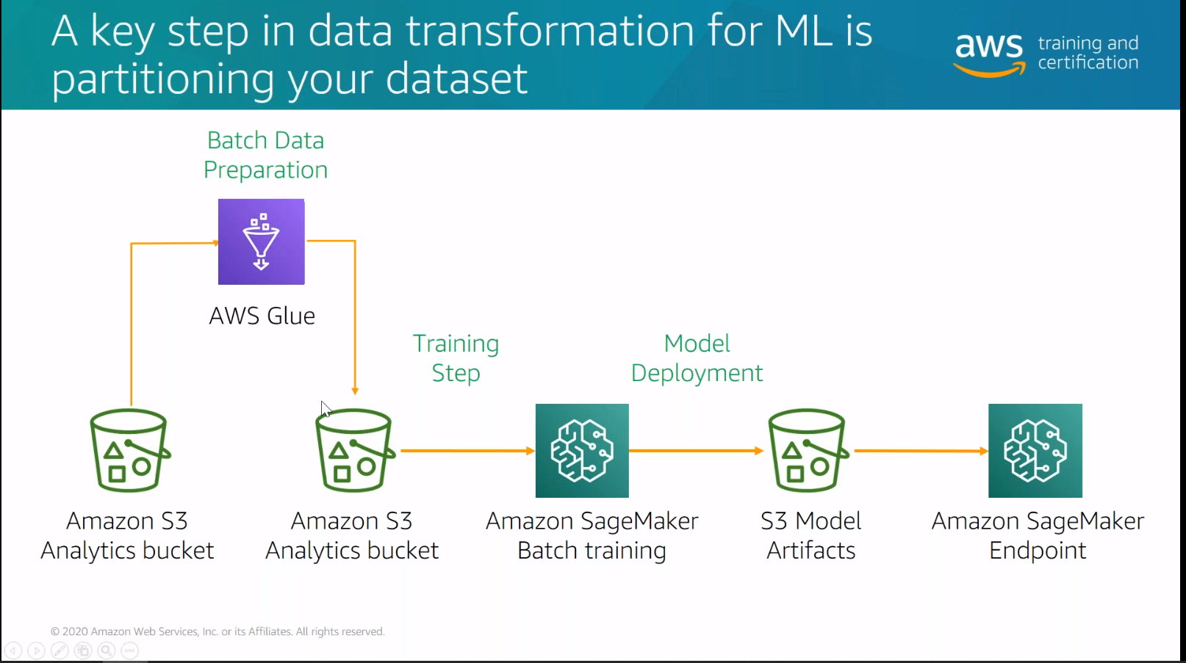
Notes:
Substitute glue for emr

Slide 34
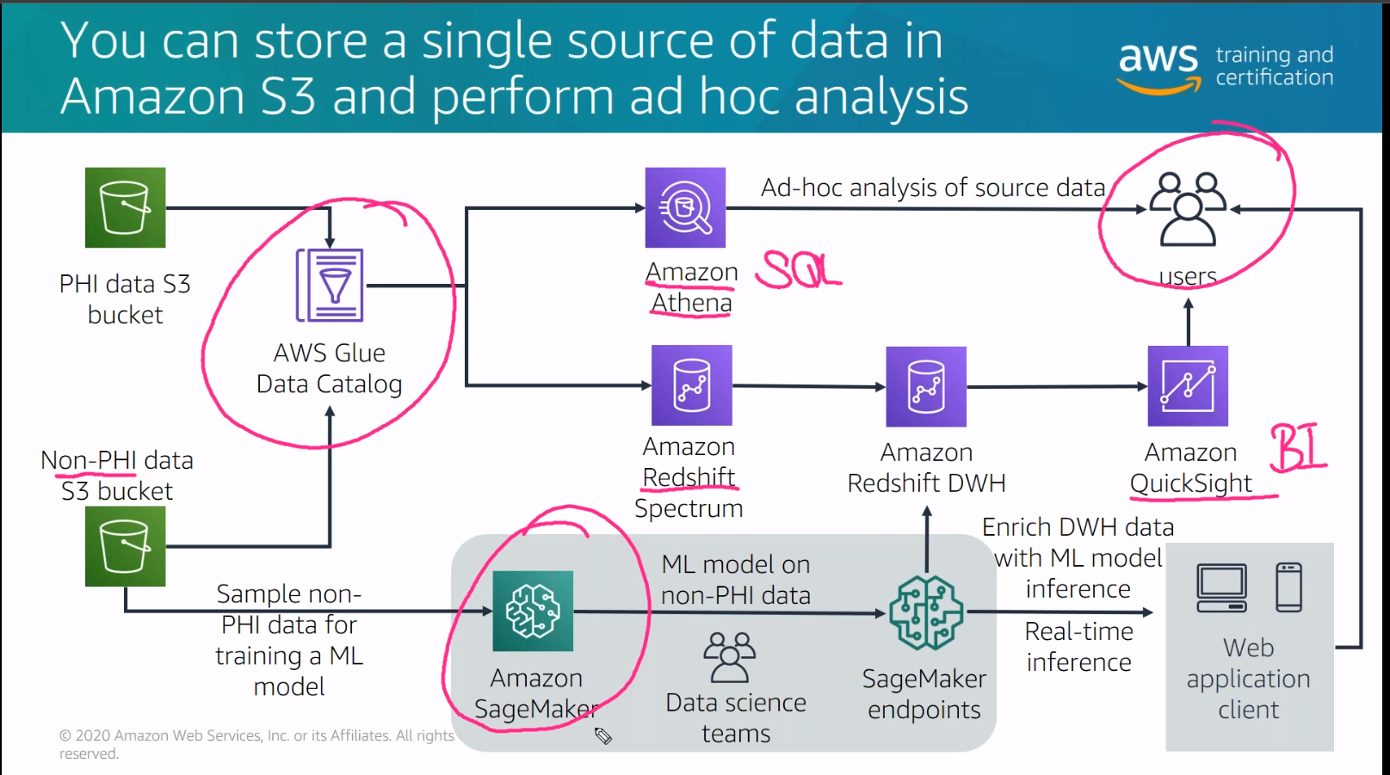
Notes:
PHI – personal health information
non-phi – Anonamyzed phi

Slide 35
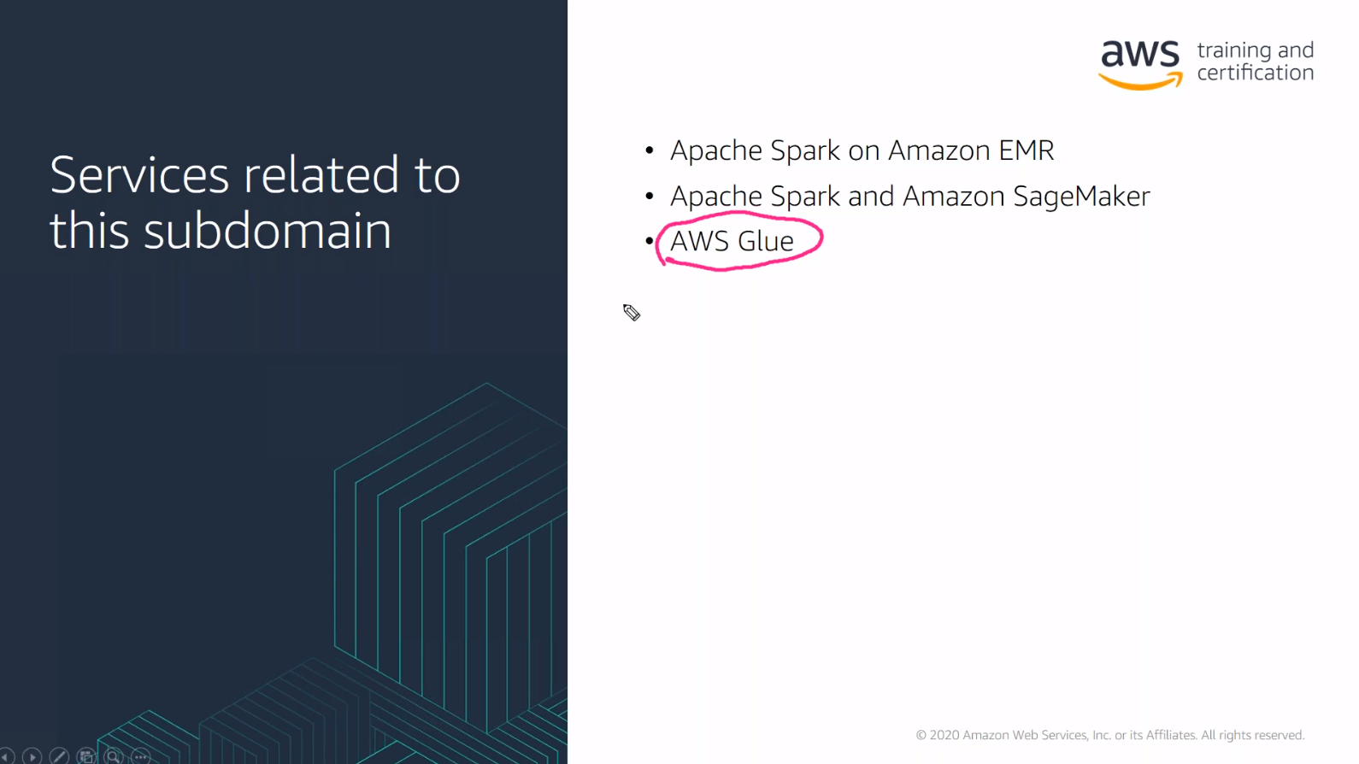

Slide 36


Slide 37
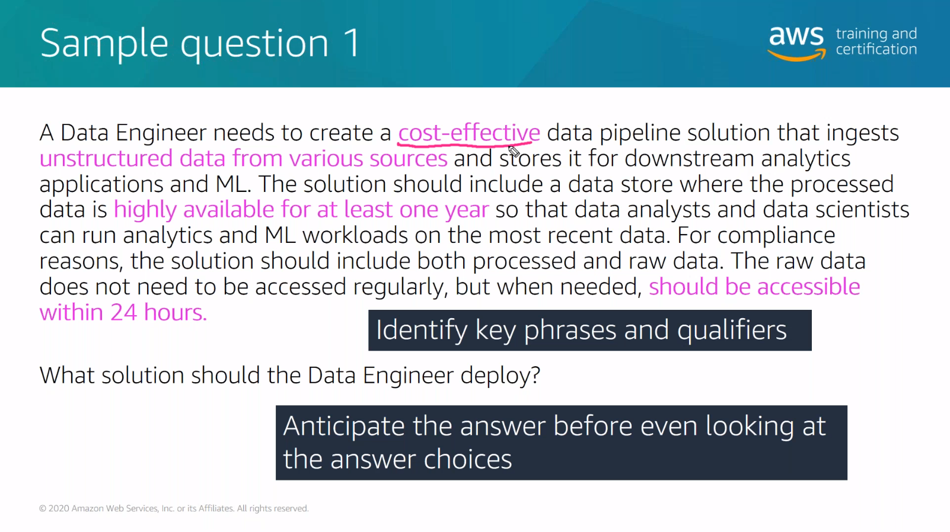

Slide 38
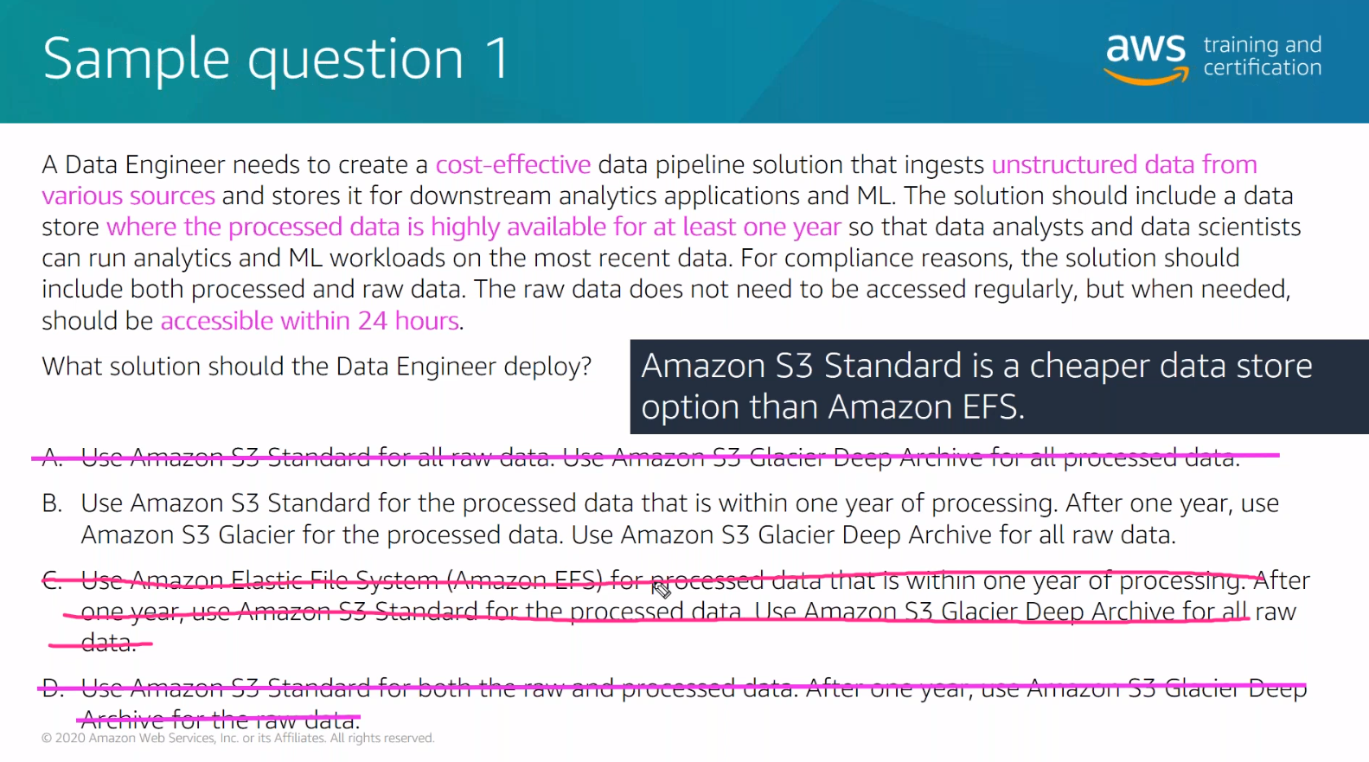
Notes:
cost effective –efs is more expensive, s3 for all is also not cost effective
unstructured – rds database/datawarehouse are not suitable
highly available -

Slide 39
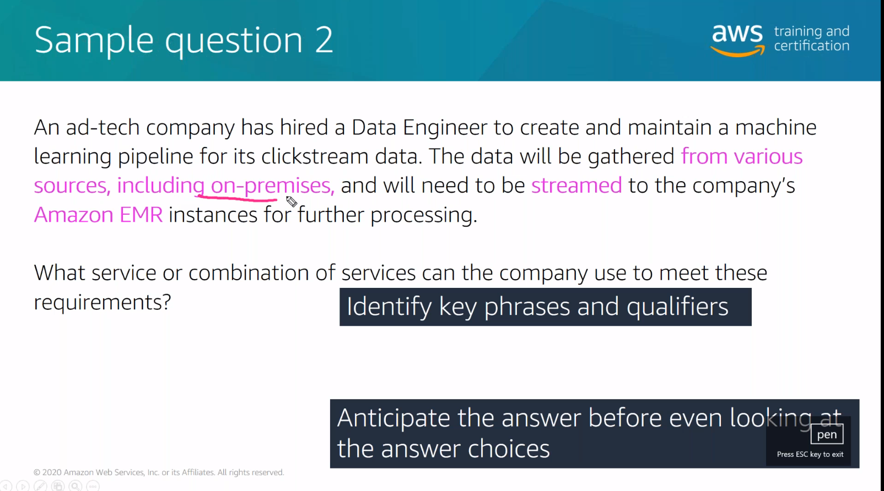

Slide 40
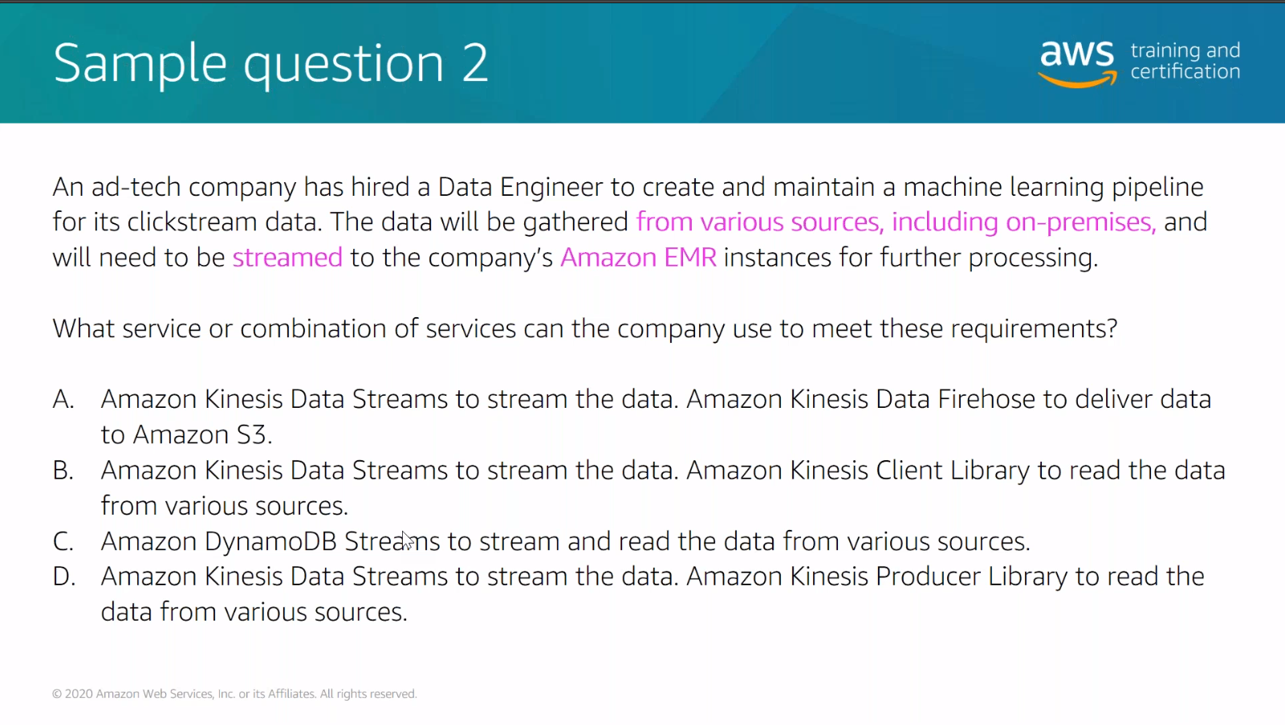

Slide 41
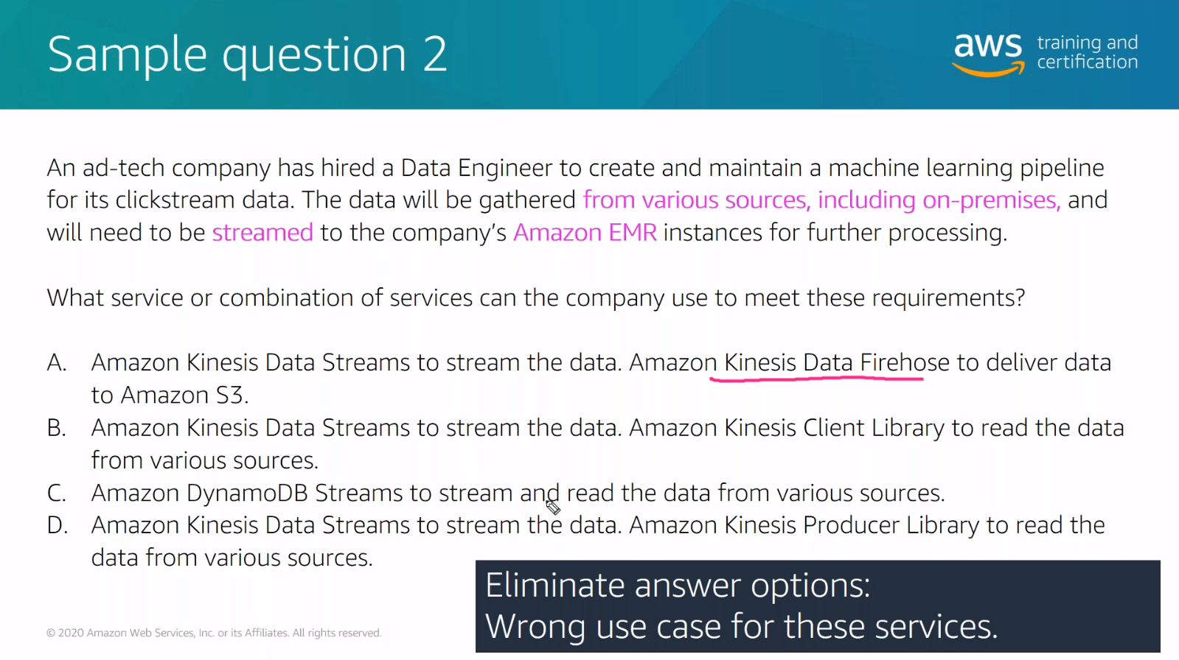
Notes:
Kineses data firehose - No need to store data in s3
Dynamo DB is also not

Slide 42
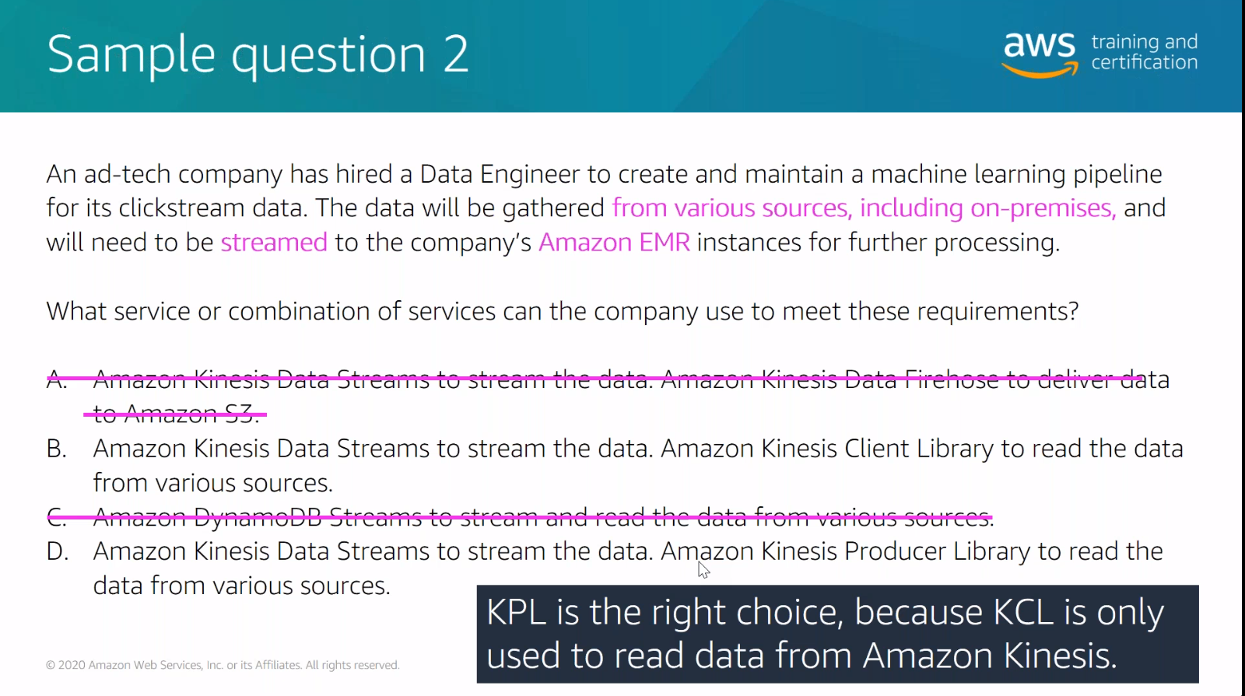

Slide 43
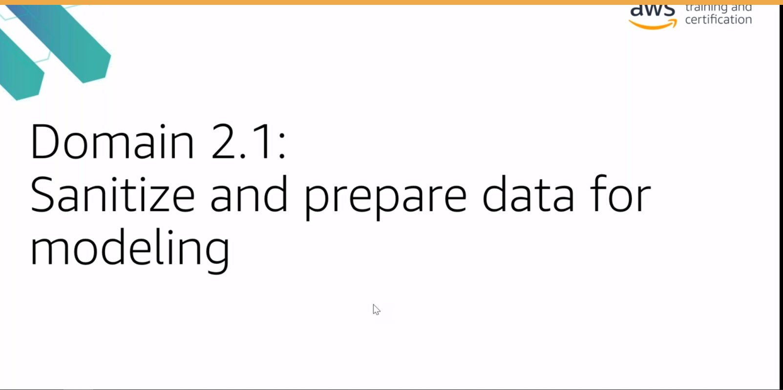

Slide 44
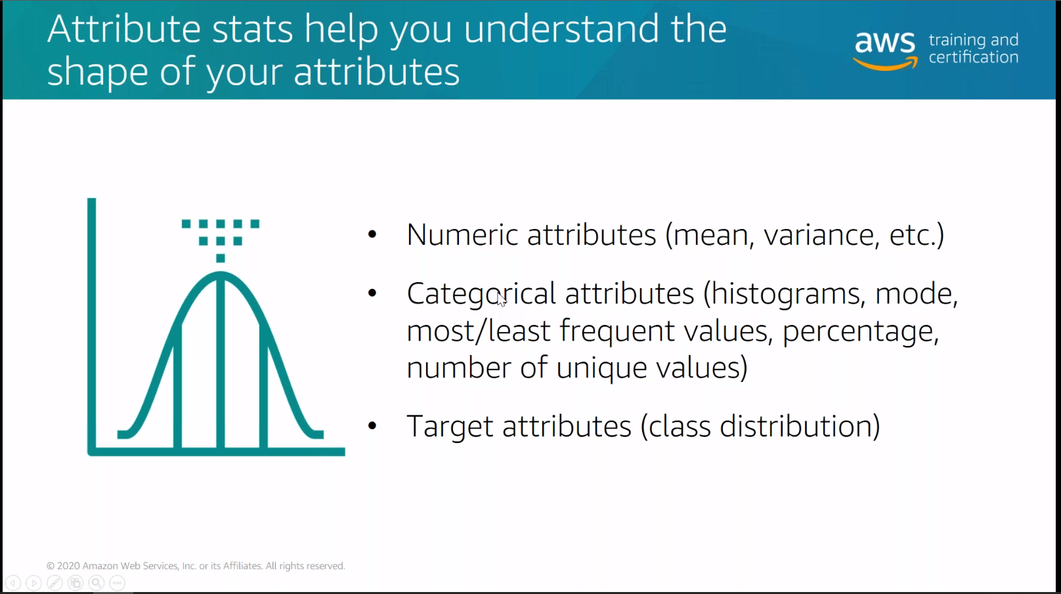

Slide 45
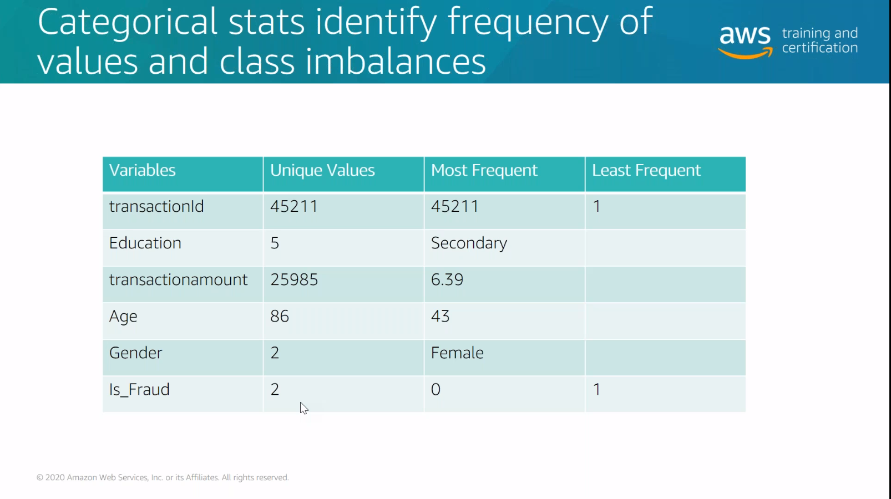

Slide 46
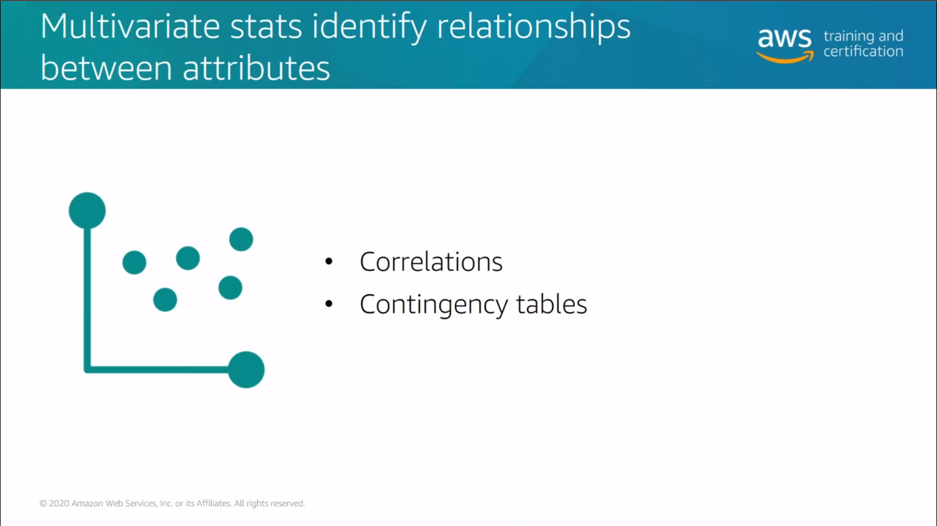

Slide 47
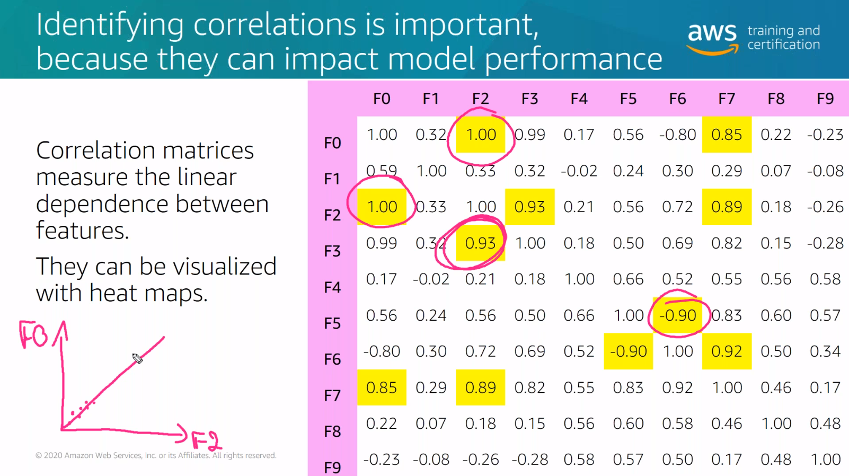

Slide 48
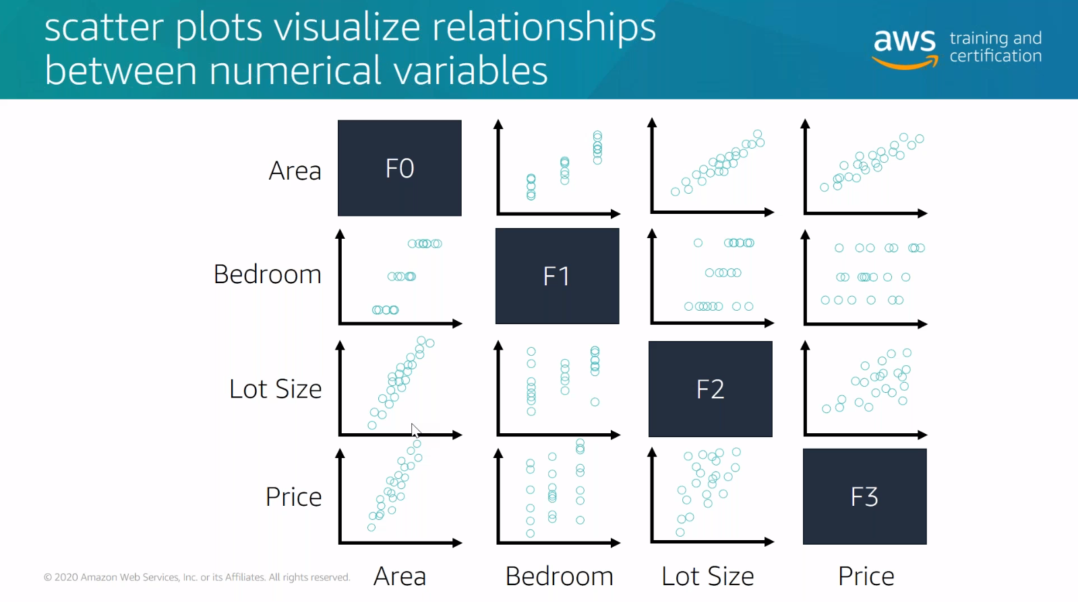

Slide 49


Slide 50
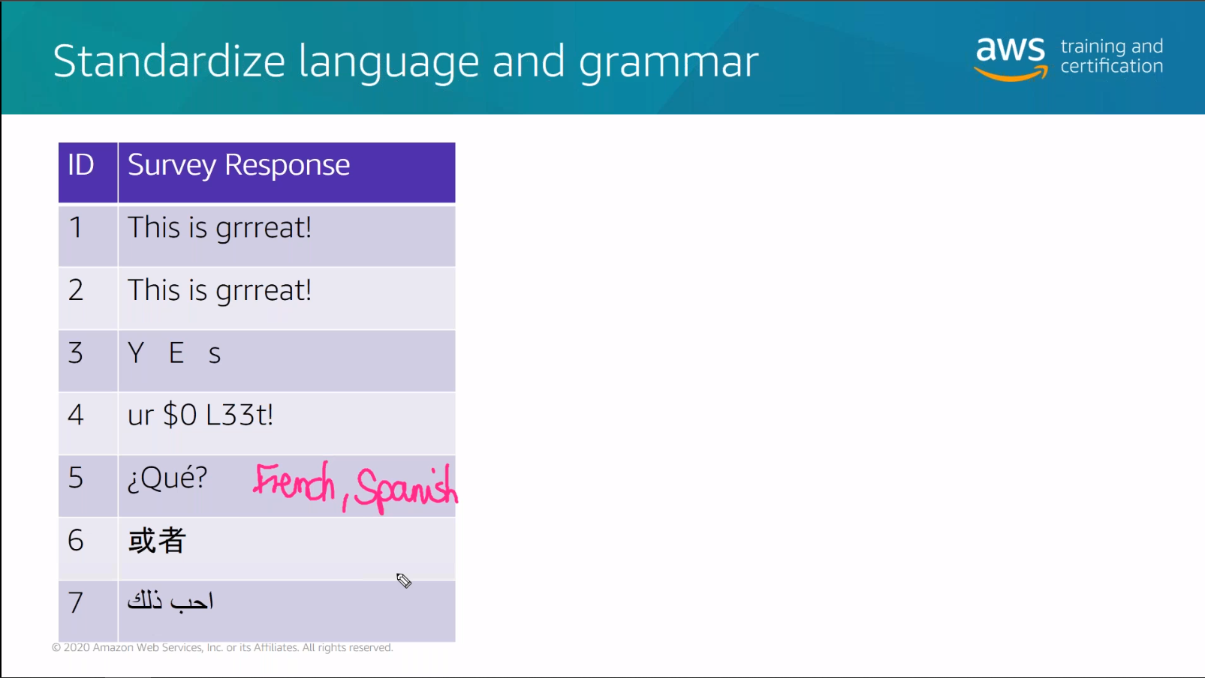

Slide 51
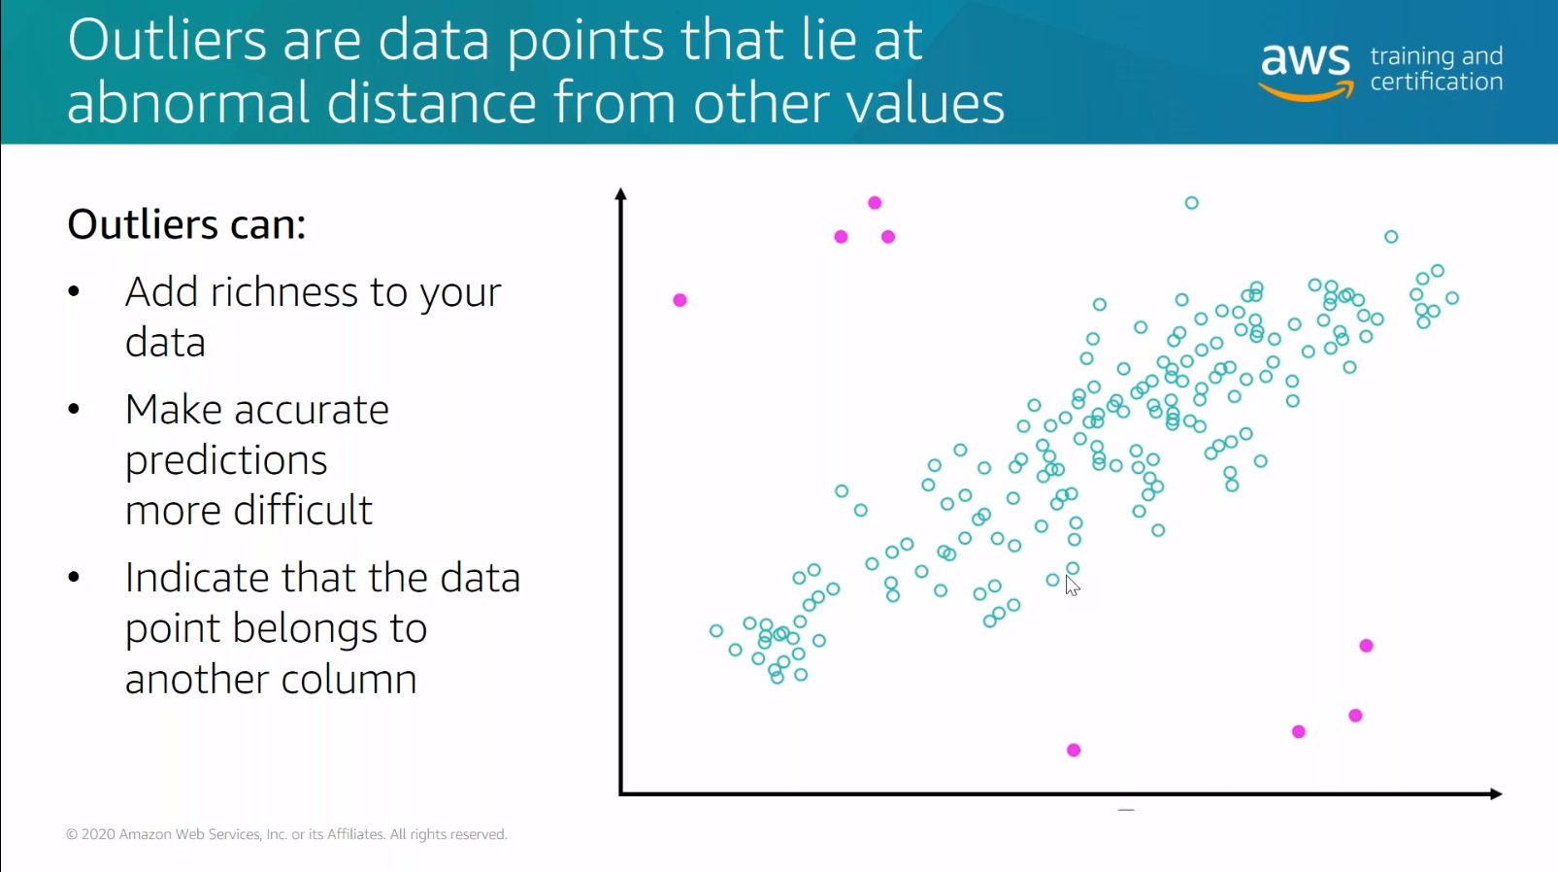

Slide 52
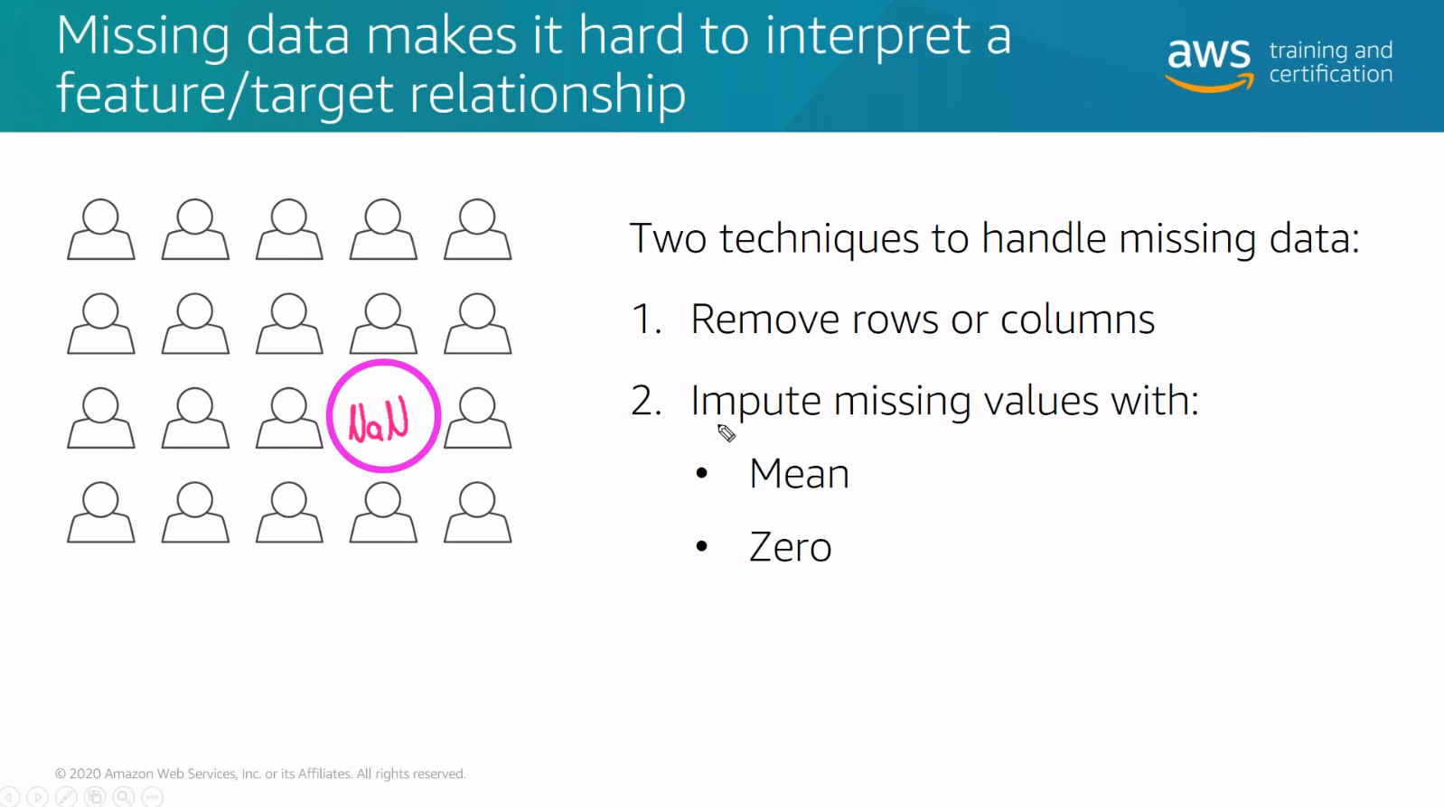

Slide 53
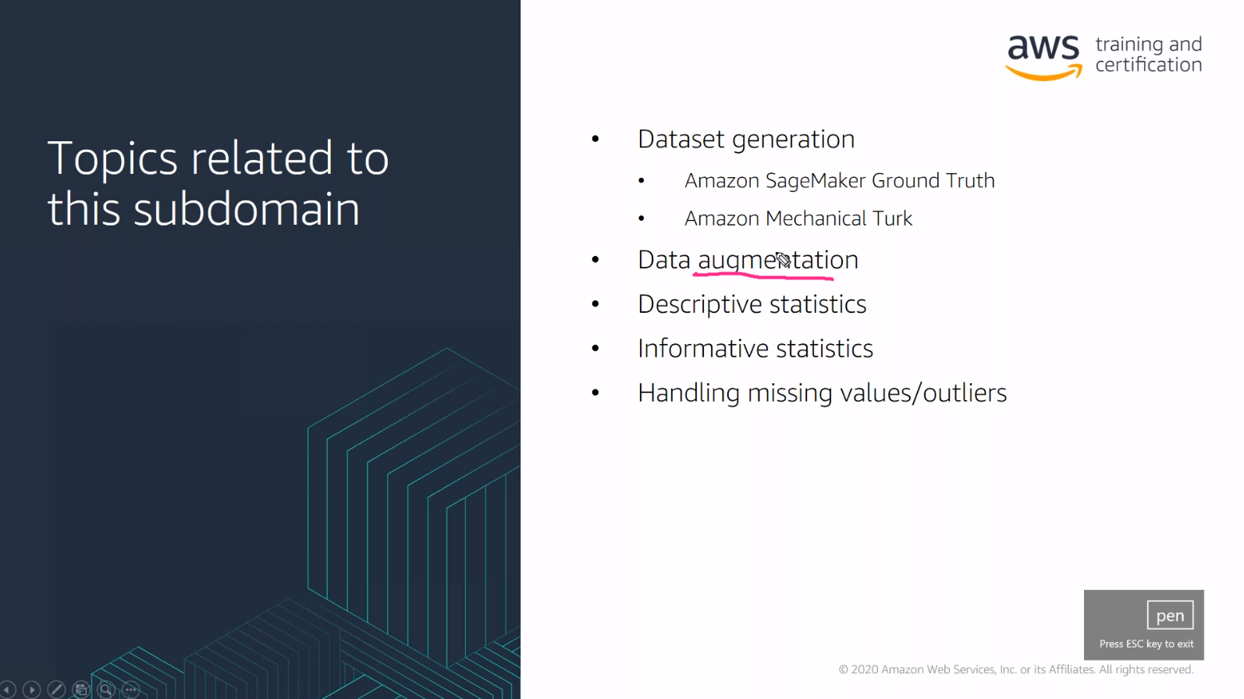

Slide 54
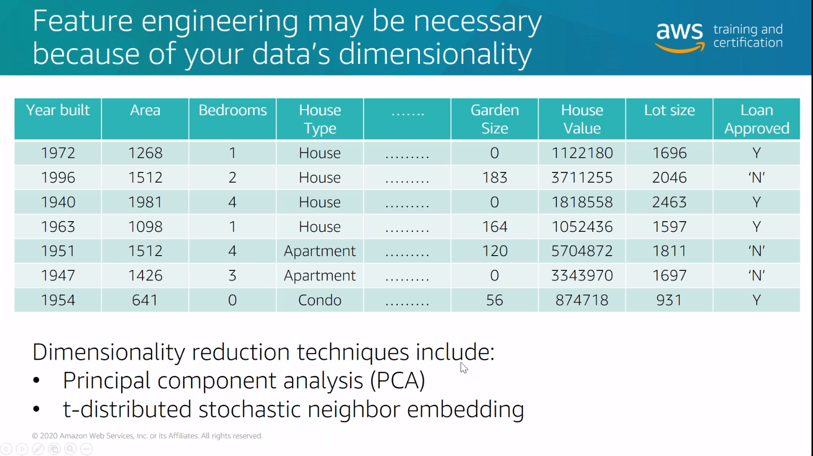

Slide 55
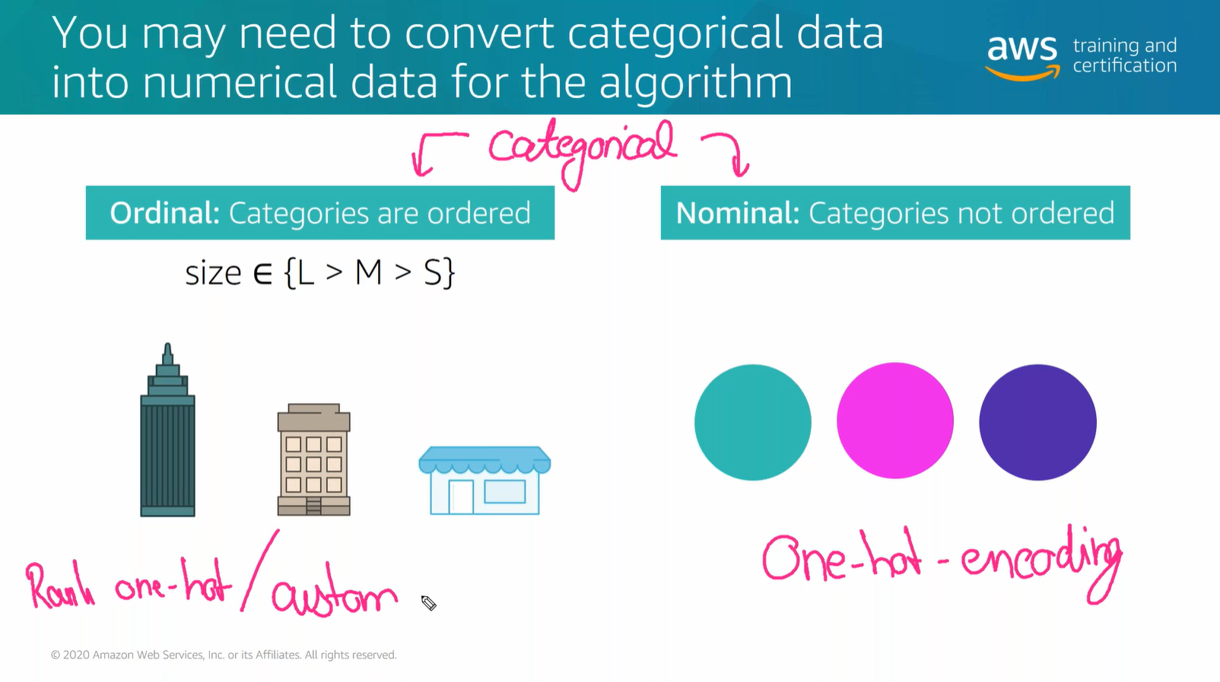

Slide 56
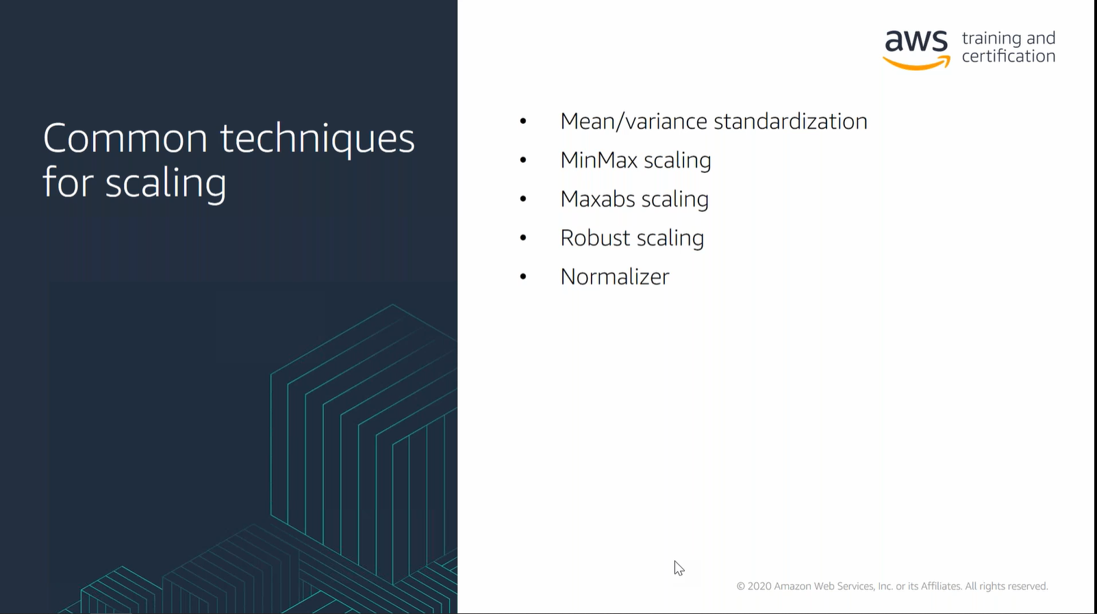

Slide 57
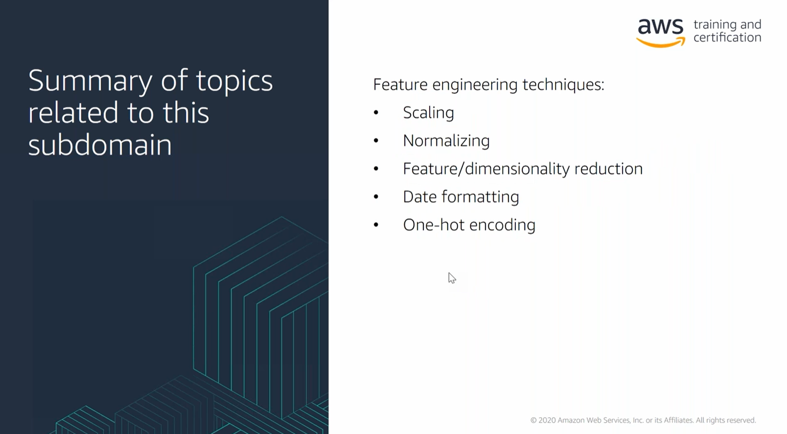

Slide 58


Slide 59
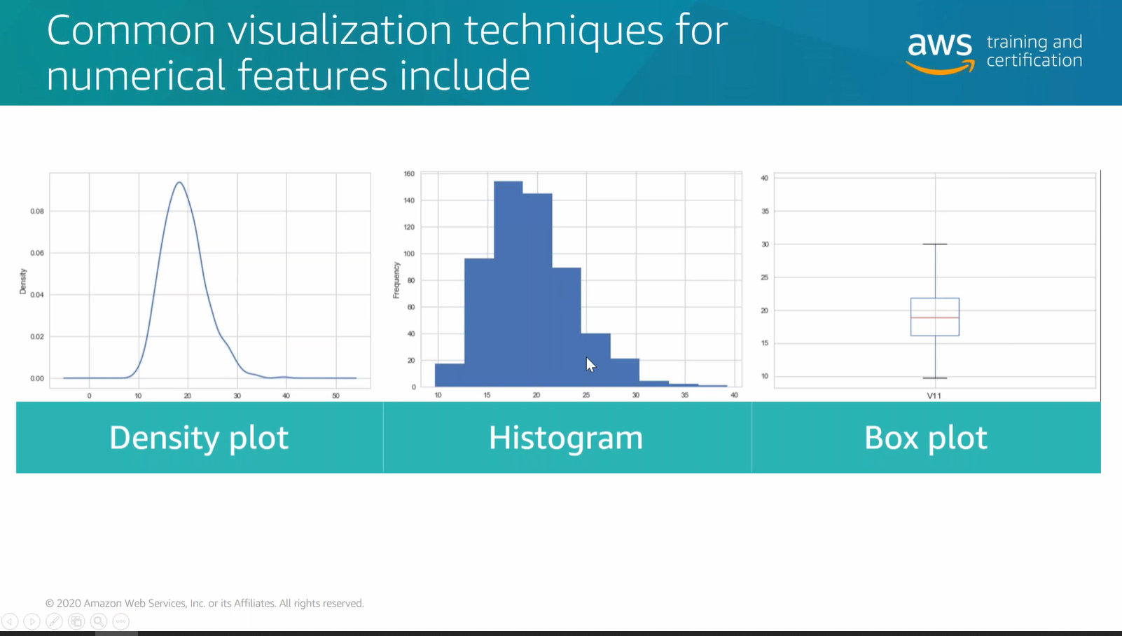

Slide 60
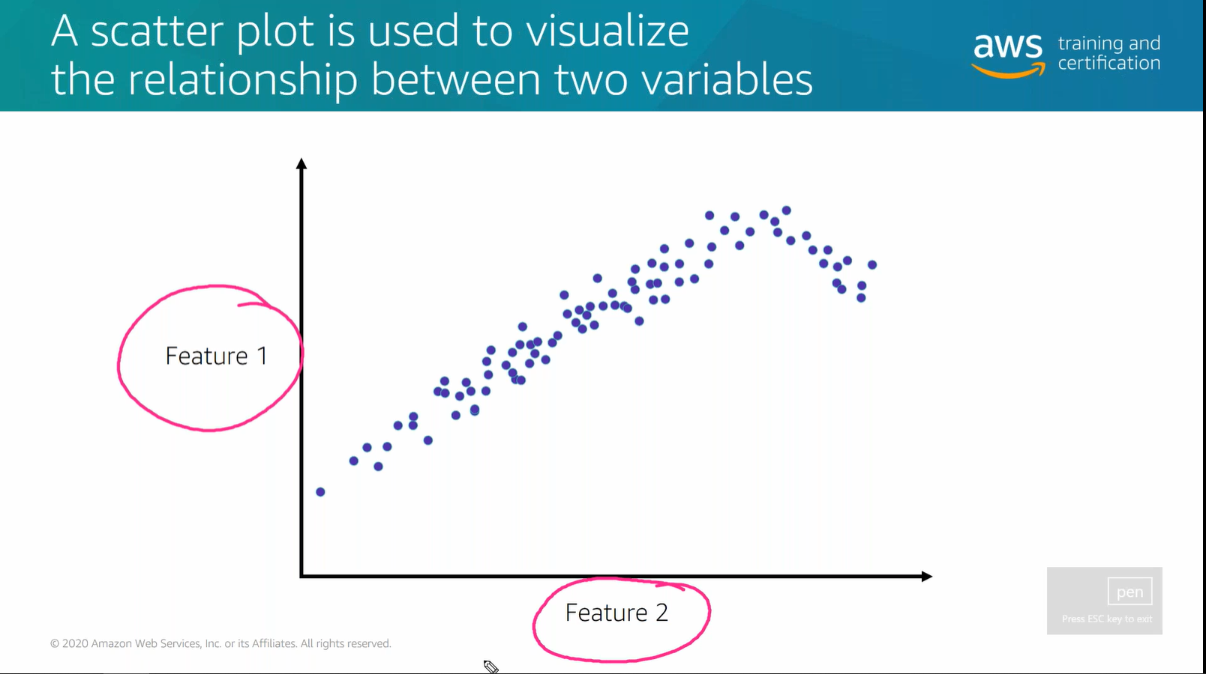

Slide 61


Slide 62


Slide 63


Slide 64


Slide 66


Slide 67


Slide 68


Slide 69


Slide 70


Slide 71


Slide 72


Slide 73


Slide 74


Slide 75


Slide 76


Slide 77


Slide 78


Slide 79


Slide 80


Slide 81


Slide 82


Slide 83


Slide 84


Slide 85


Slide 86


Slide 87


Slide 88


Slide 90


Slide 91


Slide 92

Notes:
API Gateway to sagemaker direct connection not possible

Slide 93


Slide 94


Slide 95


Slide 96


Slide 97


Slide 98


Slide 99


Slide 100


Slide 101

Notes:
VPC Endpoint allows you to use only other AWS services

Slide 102

Notes:
KMS – key management service

Slide 103


Slide 104

Notes:
C- Means you manage
KMS – AWS Manages the KEy

Slide 105


Slide 106


Slide 107
DEPLOYMENT

Slide 108


Slide 109


Slide 110


Slide 111


Slide 112


Slide 113


Slide 114


Slide 115


Slide 116


Slide 117


Slide 118


Slide 119


Slide 120


